Slide 1
‘Regional’ Meeting
Zoom Video Conference, 23 April 2020

Slide 2
Agenda
Welcome / Introductions
Opening prayer
COVID-19: Missio’s response
Mill Hill Update
2019 Results
EMM 2019
Regional Community Fundraisers
AGM Update
Q&A
Closing prayer

Slide 3
‘Regional’ Meeting
Zoom Video Conference, 23 April 2020

Slide 4
COVID-19 – Communications
Email to Local Secretaries (17 March)
1487 emailed (2272 total LSes); 73.3% open rate
Also sent to ALL LSes via post (with Thank You poster in South; separate letter in North)
Email to all Parish Priests (17 March)
2008 emailed; 40.2% open rate
Email to all Supporters (6 April)
9668 emailed; 51.8% open rate

Slide 5
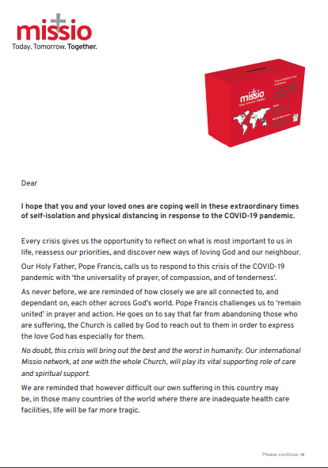
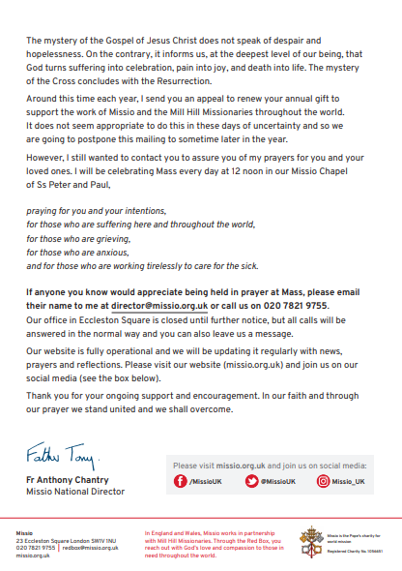

Slide 6
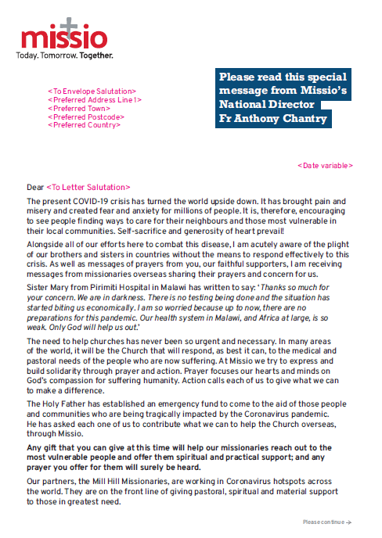

Slide 7
‘Regional’ Meeting
Zoom Video Conference, 23 April 2020

Slide 8
 | 2014 | 2015 | 2016 | 2017 | 2018 | 2019 | + / - | % Change
Arundel & Brighton | £ 165,556.00 | £ 173,873.00 | £ 162,881.00 | £ 164,287.00 | £ 157,184.00 | £ 162,867.00 | £ 5,683.00 | 3.62%
Birmingham | £ 280,952.00 | £ 289,028.00 | £ 300,143.00 | £ 297,527.00 | £ 289,552.00 | £ 281,304.00 | -£ 8,248.00 | -2.85%
Brentwood | £ 92,979.00 | £ 87,014.00 | £ 85,798.00 | £ 90,864.00 | £ 92,051.00 | £ 92,344.00 | £ 293.00 | 0.32%
Cardiff | £ 96,711.00 | £ 90,748.00 | £ 95,316.00 | £ 94,768.00 | £ 86,331.00 | £ 91,261.00 | £ 4,930.00 | 5.71%
Clifton | £ 118,407.00 | £ 125,779.00 | £ 123,376.00 | £ 122,939.00 | £ 117,214.00 | £ 114,942.00 | -£ 2,272.00 | -1.94%
East Anglia | £ 52,017.00 | £ 49,226.00 | £ 49,334.00 | £ 59,338.00 | £ 59,579.00 | £ 60,859.00 | £ 1,280.00 | 2.15%
Hallam | £ 46,081.00 | £ 45,153.00 | £ 46,470.00 | £ 42,681.00 | £ 42,081.00 | £ 43,046.00 | £ 965.00 | 2.29%
Hexham & Newcastle | £ 248,731.00 | £ 242,325.00 | £ 241,625.00 | £ 233,983.00 | £ 220,260.00 | £ 219,624.00 | -£ 636.00 | -0.29%
Lancaster | £ 94,060.00 | £ 94,172.00 | £ 92,742.00 | £ 92,901.00 | £ 83,942.00 | £ 81,822.00 | -£ 2,120.00 | -2.53%
Leeds | £ 94,266.00 | £ 106,070.00 | £ 94,874.00 | £ 93,718.00 | £ 86,358.00 | £ 81,148.00 | -£ 5,210.00 | -6.03%
Liverpool | £ 364,242.00 | £ 353,193.00 | £ 351,162.00 | £ 332,340.00 | £ 323,822.00 | £ 314,110.00 | -£ 9,712.00 | -3.00%
Menevia | £ 30,986.00 | £ 29,356.00 | £ 32,047.00 | £ 32,042.00 | £ 31,617.00 | £ 32,799.00 | £ 1,182.00 | 3.74%
Middlesbrough | £ 75,915.00 | £ 76,973.00 | £ 75,724.00 | £ 76,170.00 | £ 73,945.00 | £ 71,839.00 | -£ 2,106.00 | -2.85%
Northampton | £ 56,375.00 | £ 54,806.00 | £ 65,508.00 | £ 68,606.00 | £ 72,485.00 | £ 80,074.00 | £ 7,589.00 | 10.47%
Nottingham | £ 89,788.00 | £ 97,496.00 | £ 101,924.00 | £ 105,136.00 | £ 105,157.00 | £ 99,203.00 | -£ 5,954.00 | -5.66%
Plymouth | £ 85,293.00 | £ 86,417.00 | £ 104,617.00 | £ 85,409.00 | £ 78,060.00 | £ 85,758.00 | £ 7,698.00 | 9.86%
Portsmouth | £ 152,508.00 | £ 149,417.00 | £ 151,870.00 | £ 152,081.00 | £ 155,523.00 | £ 153,912.00 | -£ 1,611.00 | -1.04%
Salford | £ 285,911.00 | £ 270,997.00 | £ 271,564.00 | £ 256,311.00 | £ 249,275.00 | £ 237,753.00 | -£11,522.00 | -4.62%
Shrewsbury | £ 129,975.00 | £ 124,991.00 | £ 129,374.00 | £ 134,153.00 | £ 130,617.00 | £ 133,031.00 | £ 2,414.00 | 1.85%
Southwark | £ 203,451.00 | £ 208,325.00 | £ 204,869.00 | £ 209,562.00 | £ 197,982.00 | £ 198,766.00 | £ 784.00 | 0.40%
Westminster | £ 201,703.00 | £ 208,968.00 | £ 219,575.00 | £ 242,722.00 | £ 199,284.00 | £ 179,420.00 | -£19,864.00 | -9.97%
Wrexham | £ 24,703.00 | £ 22,511.00 | £ 22,021.00 | £ 21,794.00 | £ 25,839.00 | £ 27,224.00 | £ 1,385.00 | 5.36%
Anonymous/Other | £ 24,698.00 | £ 7,978.00 | £ 16,717.00 | £ 19,302.00 | £ 15,538.00 | £ 25,298.00 | £ 9,760.00 | 62.81%
Totals | £ 3,015,308.00 | £ 2,994,816.00 | £ 3,039,531.00 | £ 3,028,634.00 | £ 2,893,696.00 | £ 2,868,404.00 | -£25,292.00 | -0.87%

Slide 9
 | 2014 | 2015 | 2016 | 2017 | 2018 | 2019 | + / - | %
Southern Diocese | £ 1,806,102.00 | £ 1,805,933.00 | £ 1,865,370.00 | £ 1,900,530.00 | £ 1,814,013.00 | £ 1,819,062.00 | £ 5,049.00 | 0.28%
Northern Diocese | £ 1,209,206.00 | £ 1,188,883.00 | £ 1,174,161.00 | £ 1,128,104.00 | £ 1,079,683.00 | £ 1,049,342.00 | -£30,341.00 | -2.81%
Totals | £ 3,015,308.00 | £ 2,994,816.00 | £ 3,039,531.00 | £ 3,028,634.00 | £ 2,893,696.00 | £ 2,868,404.00 | -£25,292.00 | -0.87%

Slide 11
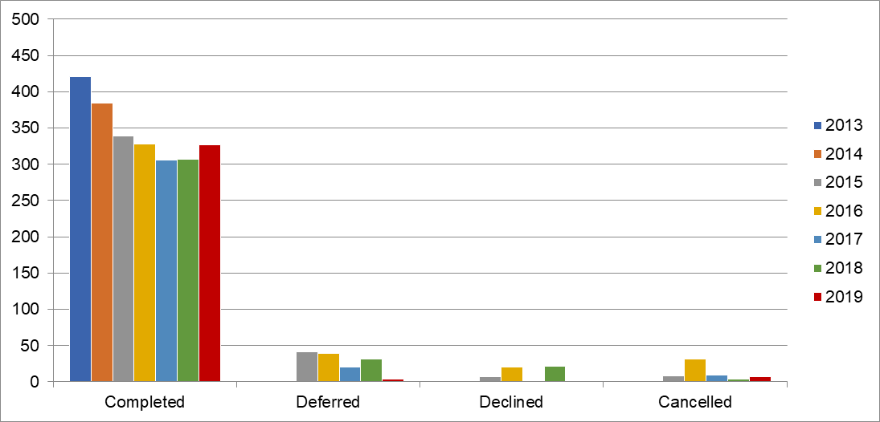
Appeals per year, per diocese 2013-2019

Slide 12
Appeals per year, per diocese 2013-2019

Slide 13
 |  |  | 2013 | 2014 | 2015 | 2016 | 2017 | 2018 | 2019
Number of Appeals |  |  | 421 | 284 | 339 | 328 | 306 | 307 | 334
New Members |  |  | 7710 | 7329 | 7981 | 6026 | 6147 | 5190 | 6136
Average per Appeal |  |  | 18 | 19 | 24 | 18 | 20 | 17 | 18
New Gift Aid Members |  |  | 3296 | 2866 | 2459 | 1867 | 1853 | 1830 | 2673
 |  |  | 43% | 39% | 31% | 31% | 30% | 35% | 44%
Direct Members |  |  | 516 | 508 | 571 | 470 | 462 | 411 | 743
 |  |  | 7% | 7% | 7% | 8% | 8% | 8% | 12%

Slide 14
‘Regional’ Meeting
Zoom Video Conference, 23 April 2020

Slide 15
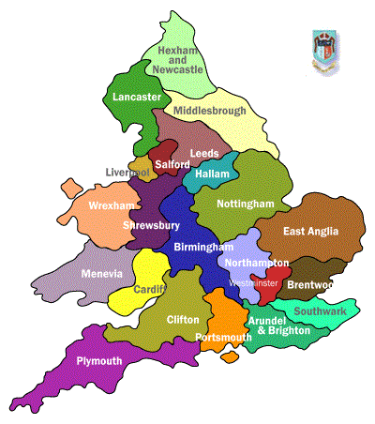
Regional Community
Fundraisers
Theresa Codd
theresa@missio.org.uk
Dave Wheat
dave@missio.org.uk

Slide 16
‘Regional’ Meeting
Zoom Video Conference, 23 April 2020

Slide 18
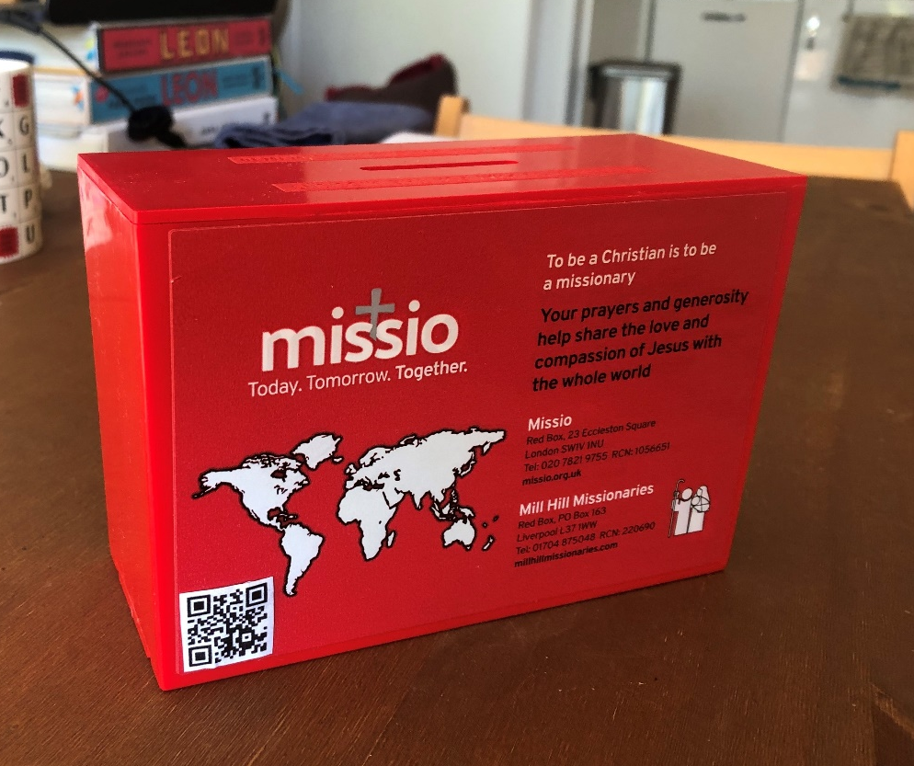
Red Box
QR Code

Slide 19
‘Regional’ Meeting
Zoom Video Conference, 23 April 2020

