Slide 1
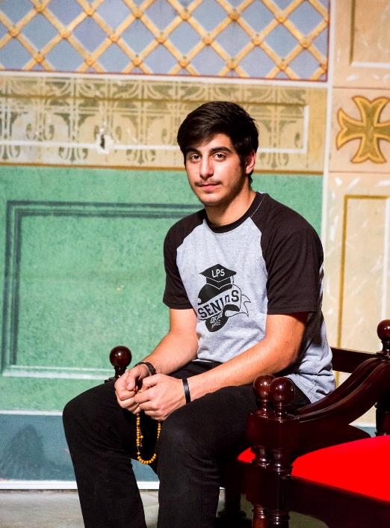
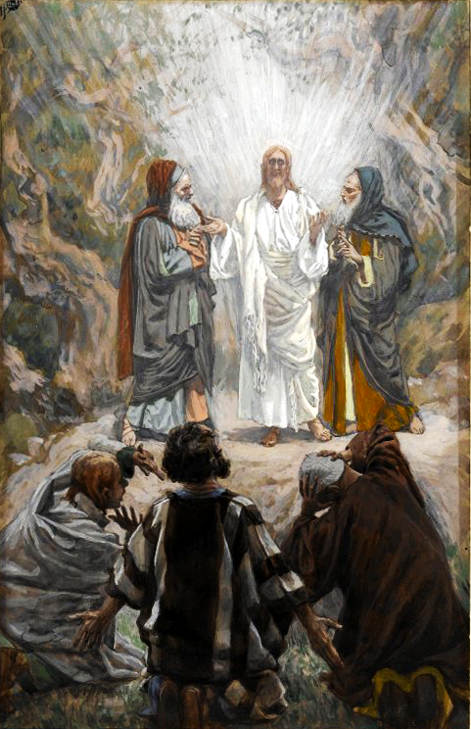
Jesus took with him Peter and James and his brother John and led them up a high mountain by themselves. There in their presence he was transfigured: his face shone like the sun and his clothes became as dazzling as light.
Suddenly Moses and Elijah appeared to them; they were talking with him. Then Peter spoke to Jesus. ‘Lord,’ he said, ‘it is wonderful for us to be here; if you want me to, I will make three shelters here, one for you, one for Moses and one for Elijah.’
He was still speaking when suddenly a bright cloud covered them with shadow, and suddenly from the cloud there came a voice which said, ‘This is my Son, the Beloved; he enjoys my favour. Listen to him.’
Matthew 17:1-5
Jesus took with him Peter and James and his brother John and led them up a high mountain by themselves. There in their presence he was transfigured: his face shone like the sun and his clothes became as dazzling as light.
Suddenly Moses and Elijah appeared to them; they were talking with him. Then Peter spoke to Jesus. ‘Lord,’ he said, ‘it is wonderful for us to be here; if you want me to, I will make three shelters here, one for you, one for Moses and one for Elijah.’
He was still speaking when suddenly a bright cloud covered them with shadow, and suddenly from the cloud there came a voice which said, ‘This is my Son, the Beloved; he enjoys my favour. Listen to him.’
Matthew 17:1-5

Slide 2
Look out for, and listen, to others.
Sometimes we fail to recognise people. We might sit in their company often, but not really notice who they are. Look for opportunities to talk and listen to others.
Learn from God how to listen well.
When we learn to listen to God through His word and in our prayer, it becomes easier to listen to people as well. Read passages from the Gospels and reflect on how Jesus listens.
Respond to the needs around you with prayer and charity.
Giving to Missio enables you, like Antoine, to share God’s love in places of poverty and conflict.
Living God,
you walk alongside us
and speak to us throughout the Scriptures.
Your Son, Jesus Christ,
listens to our hopes and fears
and shows us how to live for one another.
Send us the Holy Spirit
to open our hearts and minds
so that we may be your witnesses
throughout the world.
Amen.
Photo by Priscilla Du Preez on Unsplash

