Slide 1
Stations of the Cross – Leader’s Notes
The Stations of the Cross is a centuries-old form of prayer used traditionally in Lent. Comprising of 14 stations, each depict a moment leading up to Jesus’ crucifixion. By journeying through the stations we walk with Jesus in his final hours on earth. Praying the Station of the Cross is a powerful way to identify Christ’s suffering with our own and that of the world.
They may be used in one of three ways as follows:
A PowerPoint liturgy. If doing so, you may wish to employ the traditional opening prayer and response. This prayer and response is said at the start of each station:
Leader: We adore You, O Christ, and bless You.
All: Because by Your holy cross You have redeemed the world.
If limitations on time and space make praying the stations difficult they may be printed and situated at various points around your school/college.
You may wish to do both so that the stations are seen by students during Lent and used as a reflection in Holy Week.

Slide 2
The Stations of the Cross
First Station: Jesus is condemned to die
‘Pilate asked him, “Are you a king, then?” Jesus answered, “You say that I am a king. I was born and came into the world for this one purpose, to speak about the truth.”’ John 18:37
Jesus was not intimidated by Pilate’s power and the lies of the people. Jesus had spent his life standing up for truth and justice, he wasn’t going to stop now.
Reflection: It is nerve-racking when I am called to stand up for what is right. It is tempting to say nothing, especially if mine is a lone voice. But if I fail to speak out, I feel uneasy because I know I am not being true to myself; to the person God calls me to be.
Prayer: Lord, help me to remember that when I stand up for fairness and truth I am never alone; you are before and beside me, strengthening me always.
Mission Together is the children’s branch of Missio, around the world it is known as Holy Childhood. In Sri Lanka, Holy Childhood groups gather for rallies to speak out against social injustices and pray for change.
Holy Childhood Rally, Sri Lanka

Slide 3
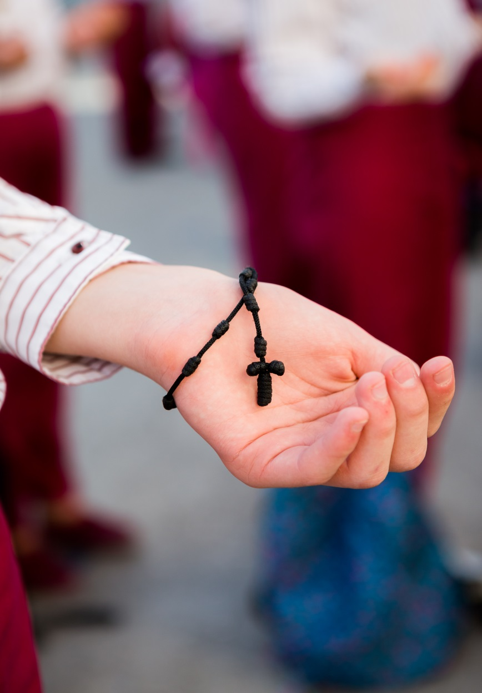
The Stations of the Cross
Second Station: Jesus takes up his cross
‘And when they had mocked him, they stripped him of the robe, and put his own clothes on him, and led him away to crucify him.’ Mt 27:31
Jesus was used to being pointed at; he didn’t act like other people, he didn’t fit in, he was ‘different’. But many had admired Jesus’ new teaching - now things were beginning to change. In just a few hours Jesus was mocked and rejected by almost everyone.
Reflection: It is a terrible feeling to be mocked and rejected, it erodes my self-worth. I doubt myself and ask, ‘What’s wrong with me?’ But often the answer lies not with me but with the offender.
Prayer: Lord, when I am mocked or bullied, help me to seek to understand and forgive, so I might never fall into the trap of bullying others in turn.
Thanks to our supporters , Missio helps fund the Marka School for Iraqi Refugees. The school provides free education to child victims of violent persecution and teaches the importance of mercy, peace, and hope.
Lunchtime prayers, The Marka school for Refugees, Jordan

Slide 4
The Stations of the Cross
Third Station: Jesus falls the first time
‘Even youths grow tired and weary, and young people stumble and fall; but those who hope in the Lord will renew their strength.’ Isaiah 40:30-31
It must have taken a while for Jesus to adjust to the weight of the rough wooden cross. His first steps would have been unsure; made worse by the push and shove of the jeering onlookers. Without help he was bound to fall.
Reflection: Whenever I enter a new stage of life it takes a while to adjust: starting a new school, moving to a new area, growing into adulthood. It’s easy to stumble as I try to work out where I fit and whom I can trust.
Prayer: Lord, guide my steps as I journey through life.
When I stumble and fall, may I always remember
that you are ready to pick me up
and encourage me to walk tall.
In Malawi, poverty means teenagers miss school and face a future of unemployment and crime. With the help of Missio’s supporters, Fr Henry founded The Pirimiti Boarding House to ensure teenagers continue their education.
Students at the Pirmiti Boarding House, Malawi, with founder Fr Henry

Slide 5
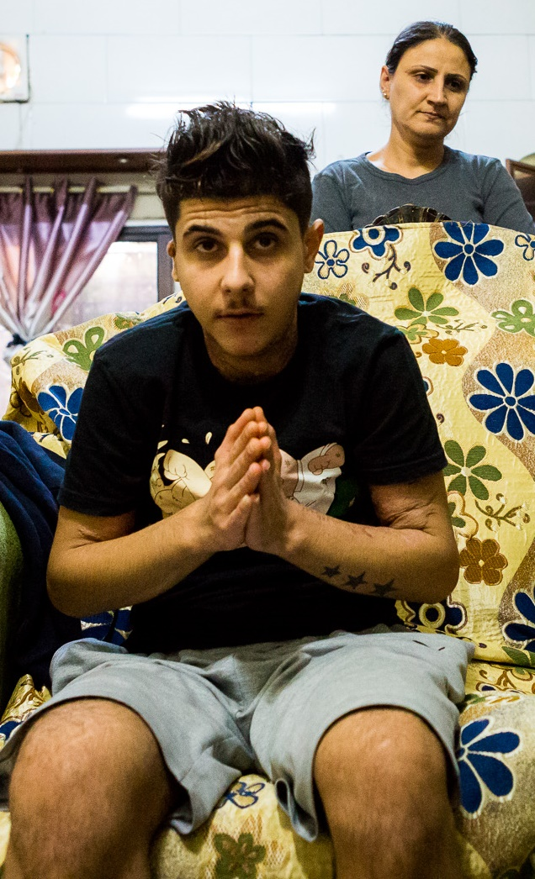
‘The Stations of the Cross
Fourth Station: Jesus meets his mother
‘God sent the angel Gabriel to a young woman named Mary... The angel said, “Peace be with you. The Lord is with you and has greatly blessed you. You will give birth to a son and name him Jesus. He will be great and called the Son of the Most High God.”’ Luke 1: 26-33
The words of the angel must seem like a distant memory for Mary; her hopes for her son now appear dashed as she sees Jesus in pain, dejected and humiliated. Since his birth she has cared for him; now, as he carries his cross, she can do no more than watch.
Reflection: It can be difficult for my family to watch as I become more independent and struggle with life’s challenges. They worry I might make the wrong choices. Sometimes this hurts all of us, but I know that, whatever happens, they love me and want the best for me.
Prayer: Lord, remind me that love costs and
to value it above all things.
Foster in me a loving, grateful and
humble heart, ready to listen and grow.
Yusef and his family left Iraq after he was attacked. Yusef was set on fire because of his faith. He and his family are supported by the local Catholic church and Missio. In spite of everything, their faith remains strong.
Yusef and his mother, Iraqi refugees, Jordan

Slide 6
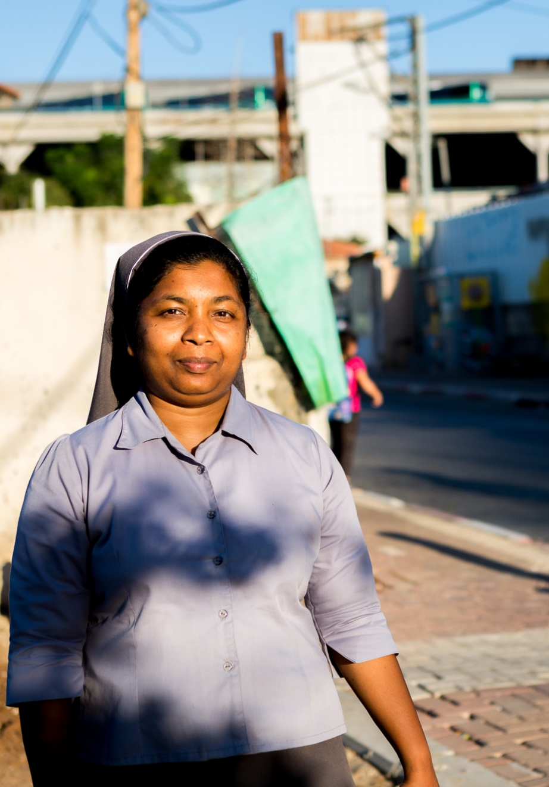
The Stations of the Cross
Fifth Station: Simon helps Jesus carry his cross
‘As the soldiers led Jesus away, they seized Simon from Cyrene, who was on his way in from the country, and put the cross on him and made him carry it behind Jesus.” Luke 23:26
Simon didn’t want to get involved. He was just trying to pass through the crowd and get on with his day. But he was picked out and forced into helping. He did - and it changed his life forever.
Reflection: Sometimes I turn away when asked to help. I feel there is little I can offer, or I’m afraid I’ll make a fool of myself. But the world is changed by people stepping forward to do whatever they can to share the load of another.
Prayer: Lord, help me to trust
that when others ask for my help
they believe I can make a difference.
Give me the courage to step forward
and get involved.
Sr Dinesha is from Sri Lanka. In 2014 she visited a refugee project in Tel Aviv. Whilst there she was asked to stay and help. She agreed and with the help of Missio’s supporters she has been serving the poor there ever since.
Sr Dinesha works with refugees and migrants in Tel Aviv’s slums

Slide 7
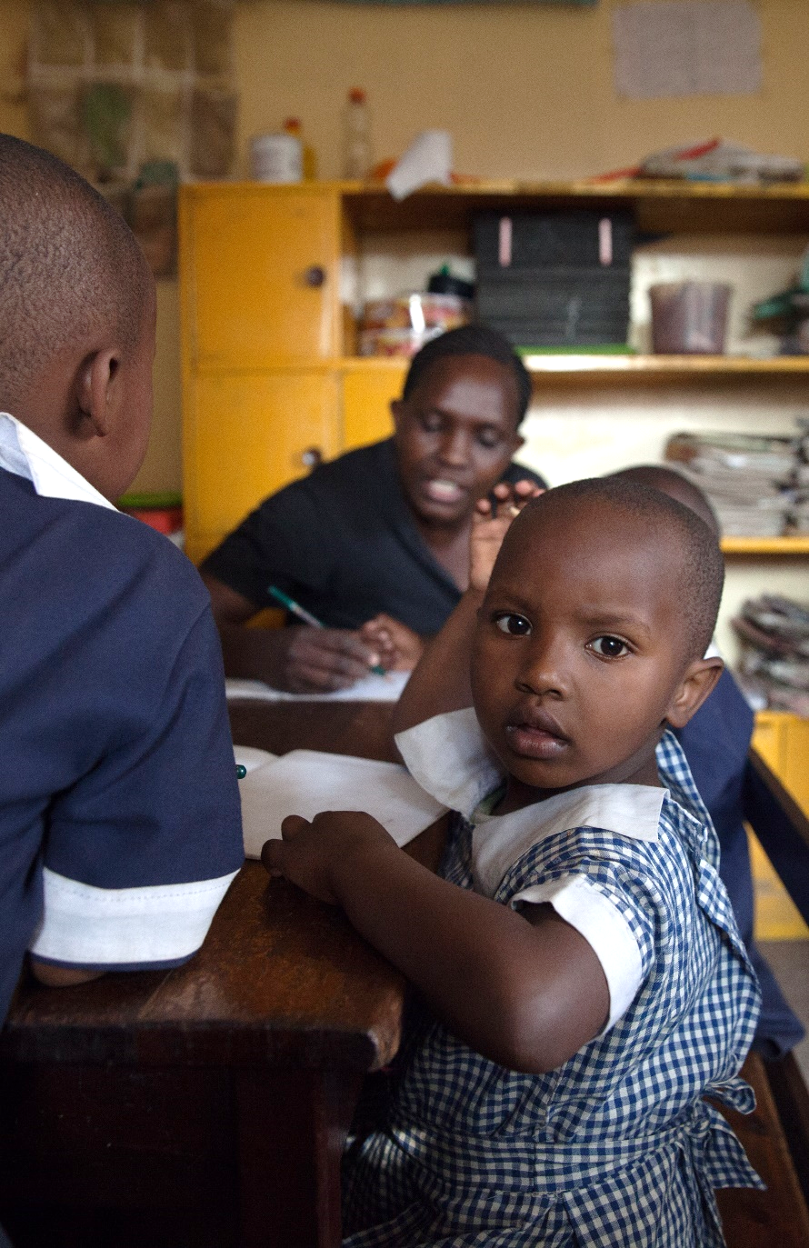
The Stations of the Cross
Sixth Station: Veronica wipes Jesus’ face
‘The King will answer them, “Amen I tell you, whatever you did for one of these brothers and sisters of mine, even the least of these, you did it to me.” Matthew 25:40
Little is known of Veronica, all we are told is that she stepped from the angry crowd to wipe Jesus’ bloody face. It is often said how brave she must have been to do this. But maybe it was her sense of compassion that was too strong to stop her offering the little care she could give.
Reflection: Compassion means I feel the pain of another deep in my heart. It allows me to identify with their struggle. It can cost me tears, make me feel small. Yet it can motivate me to step out of my ordinariness to help ease the world’s suffering. It is a gift to all.
Prayer: Lord, foster in me a compassionate heart,
brave enough to share another’s pain,
humble enough to shed a tear,
big enough to shelter their hopes,
ready, always, to care.
Missio’s supporters help finance The Rescue Dada Care Centre. Here children like Mary Ann, rescued from Nairobi's dangerous slums, are looked after and loved by staff motivated by their faith and compassion
Five year old Mary Ann at the Rescue Dada Centre, Nairobi

Slide 8
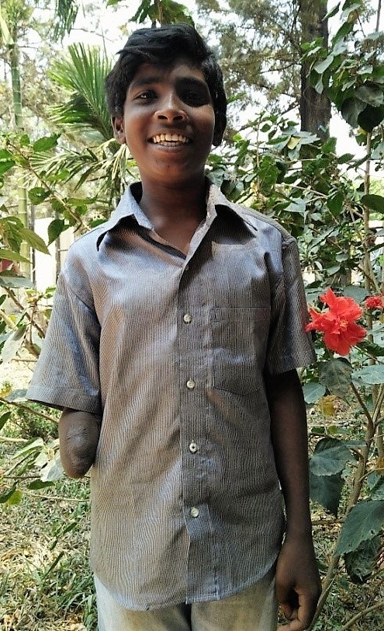
The Stations of the Cross
Seventh Station: Jesus falls a second time
‘We are often troubled, but not crushed; sometimes in doubt, but never in despair; there are many enemies, but we are never without a friend; and though badly hurt at times, we are not destroyed.’ 2 Corinthians 4:8-9
The wood of the cross and the people’s rejection must have weighed heavier and heavier on Jesus’ body and heart. It must have been ever harder to go on as he stumbled through the streets of Jerusalem.
Reflection: Sometimes life delivers a series of blows and I feel as if I can’t take anymore. It is then I recognise the value of resilience. Resilience is the ability to recover after set-backs. It is strengthened by faith, that no matter how low I feel, with God’s help I can rise up again.
Prayer: Lord, remind me when life is hard,
that you never leave me to face my difficulties alone.
Help me to see that you work through others;
picking me up and restoring my strength.
Samuel is familiar with hard times. Raised in poverty in Bangalore’s slums, as a boy he lost his arm in an accident. His mother, unable to care for Samuel, moved him into St Mary’s, an orphanage partly financed by Missio. Here Samuel receives a free education, medical care, and is learning how to be a carpenter.
Samuel, resident at St Mary’s Orphanage, Bangalore

Slide 9
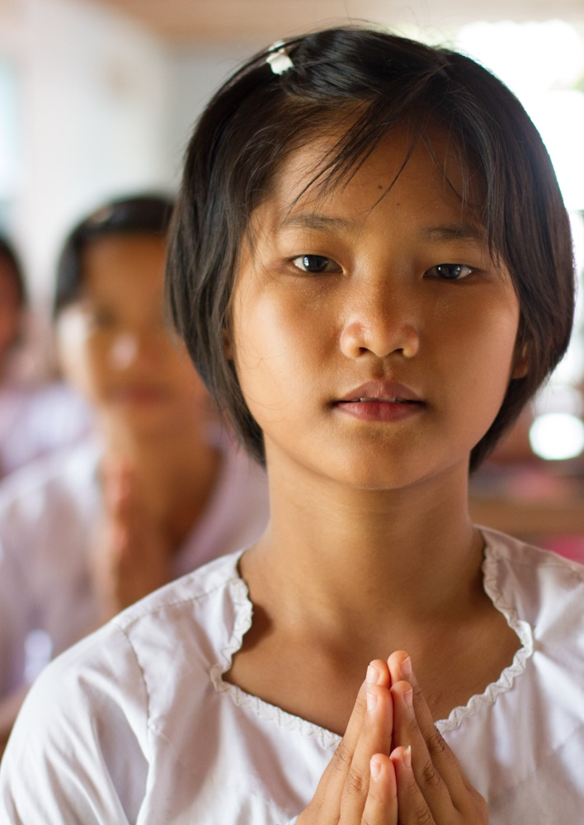
The Stations of the Cross
Eighth Station: Jesus meets the women of Jerusalem
‘A large crowd of people followed him; among them were some women who were weeping and wailing for him.’ Luke 23:27
Amidst the jeering crowd there was one group of women who refused to turn their back on their friend and teacher, Jesus. They withstood pressures to deny him or run away. Although it made them outsiders, their faith in him remained steadfast.
Reflection: It can be difficult to live out my faith when the world around me doesn’t. I can feel pressured into ‘fitting in’ by not wanting to stand out. It takes courage to remain faithful to a way of life and to support others as they follow their chosen path.
Prayer: Lord, help me to be faithful;
to my friends, to my family, to my beliefs.
Never let the pressure to fit in,
prevent me from standing out.
Partly funded by Missio, St Rita's Boarding House provides Myanmar’s orphans and disadvantaged teenagers with education, care, and security. Christians are a minority in Myanmar and like many places around the world it can be difficult to live out the faith. St Rita’s encourages its residents to grow in understanding and confidence
Students at St Rita’s Boarding House, Myanmar

Slide 10
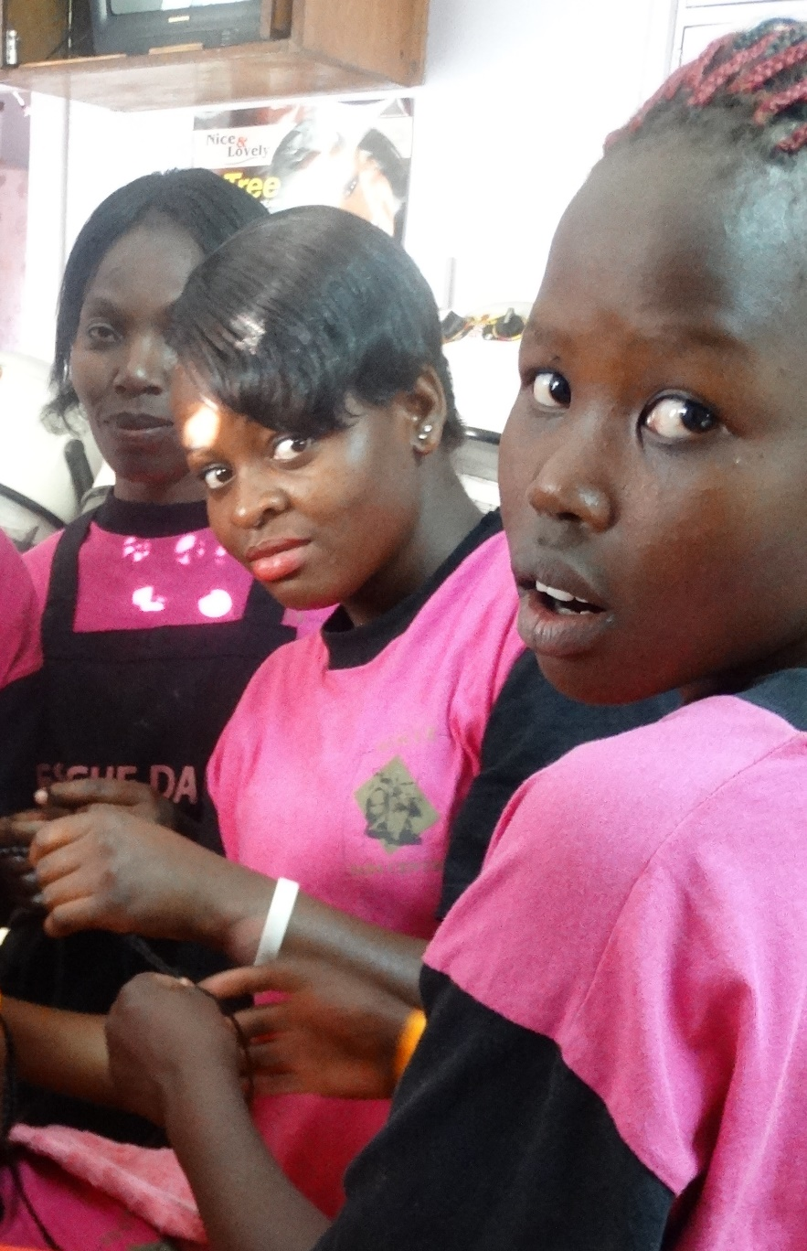
The Stations of the Cross
Ninth Station: Jesus falls a third time
‘Our enemies have no reason to gloat over us. We have fallen, but we will rise again. We are in darkness now, but the Lord will give us light.’ Micah 7:8
Jesus has almost reached the end. By his third fall many will have considered him a failure. How could someone who performed miracles and awed thousands now look so weak and hopeless?
Reflection: The world has always prized successful people, but the lesson of the cross shows me that it is human to fail. With God however, I can’t stay down. He lets my failures teach me to be humble, resilient and forgiving, not just of my own errors but those of others too.
Prayer: Lord, there are so many reasons
as to why we fail. Lack of effort,
lack of support, lack of belief.
Help me to give witness to the truth,
that with You there are always fresh starts.
The Cardinal Maurice Otunga Empowerment Centre, is a residential centre backed by Missio supporters, It provides rehabilitation, education and training for young women rescued from Nairobi's slums.
Residents at Cardinal Maurice Otunga Girls Empowerment Centre, Kenya

Slide 11
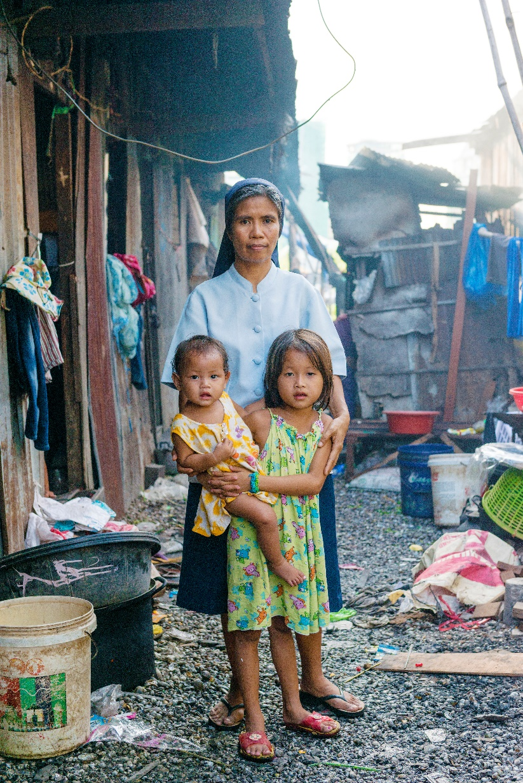
The Stations of the Cross
Tenth Station: Jesus is stripped
‘The soldiers took Jesus to a place called Golgotha, which means “The Place of the Skull”… and divided his clothes among themselves, throwing dice to see who would get which piece of clothing.’ Mark 15:22-24
After falling under the weight of carrying a criminal’s cross, being jeered at and considered a failure, Jesus’ dignity is now stripped away further as the soldiers take his clothes and leave him naked.
Reflection: I know I am made in the image of God and that I have an inbuilt dignity that deserves the upmost respect. Sometimes I don’t act in a way that is worthy of this - when I don’t respect myself by my words and actions or when I fail to acknowledge that others have their God-given dignity too.
Prayer: Lord, open my eyes and my heart,
that I can see your image in all around me.
Give me the courage to stand up
for the dignity of every person,
including myself.
Sr Eulie strives to uphold the dignity of all she serves through her work educating Cambodia’s poor children and supporting their families. Missio’s supporters help finance Sr Eulie’s vital education and welfare projects.
Sr Eulie serves the poor in Phnom Penh’s slum districts, Cambodia

Slide 12
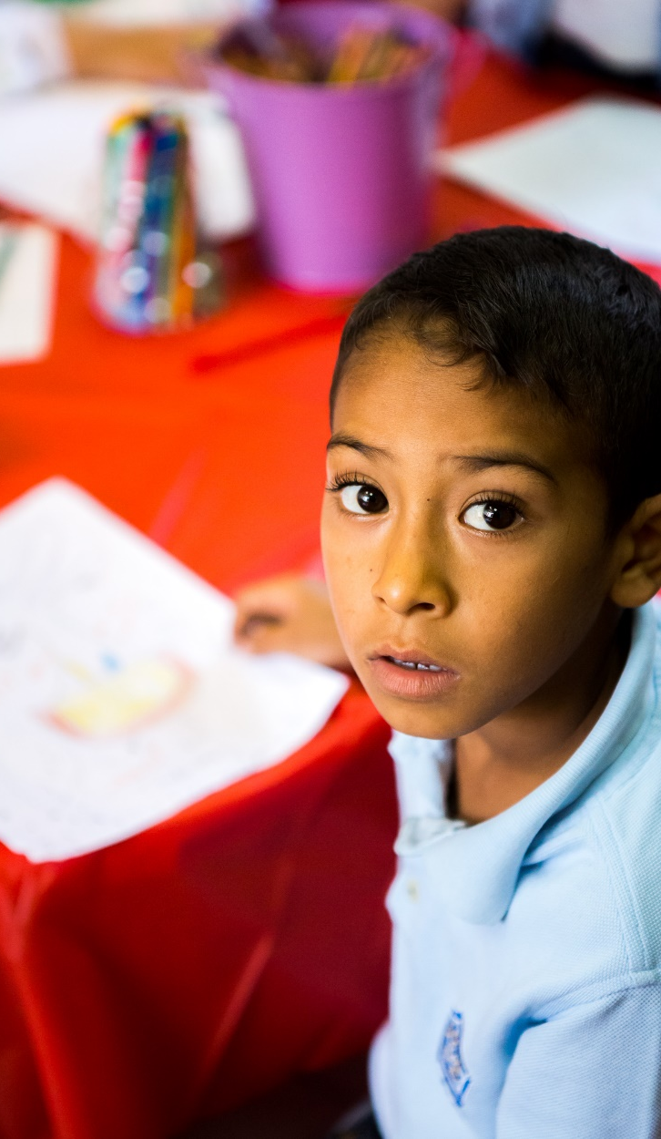
The Stations of the Cross
Eleventh Station: Jesus is nailed to the cross
‘When they came to the place called the Skull, they crucified him there, along with the criminals.’ Luke 23:33-34
It is difficult to know what caused Jesus the greatest suffering; the physical pain of being nailed to the cross or the cruel injustice inflicted on him by others.
Reflection: The cruelty I see in the news and in my community can make me feel sad and confused. How can some people be so mean? Why doesn’t God do something? Then I remember he did; he made me.
Prayer: Lord, may I never forget
that with each kind word and merciful act,
I help to create a culture of love,
that counteracts a culture of hate.
Remind me that my love makes a difference.
Elias* is a refugee from Syria. Like many Syrian children, he has witnessed war’s cruelty and violence. Missio’s supporters help finance rehabilitation and play therapy programmes for refugee children like Elias* *name changed
Syrian child refugee, Jordan

Slide 13
The Stations of the Cross
Twelfth Station: Jesus dies on the cross
‘At about three in the afternoon Jesus cried out in a loud voice…“My God, my God, why have you forsaken me?” Then with a loud cry, Jesus breathed his last.’ Mark 15:34,37
It is shocking to think that at this, his darkest hour, even Jesus doubted the Father’s presence, shocking too for those gathered to watch. Is that how it ends? Have God and goodness gone?
Reflection: It can be unnerving when someone I look up to begins to doubt themselves. I expect them always to be sure, to inspire and guide. Should I now doubt them as well? Or should I remain loyal and help restore their faith?
Prayer: Lord, help me to stay faithful
in the darkest of times.
When others lose hope,
give me the grace to help them find it.
Missio empowers local people in poor and remote areas across the world to form communities of faith. Missio also trains future local leaders so that God’s love, justice and mercy is shared with all.
A Good Friday prayer service, the Philippines

Slide 14
The Stations of the Cross
Thirteenth Station: Jesus is taken down from the cross
‘A request was put to Pilate by Joseph from Arimathea, that he might take away Jesus’ body. And Pilate gave permission. So he came and took his body away.’ John 19:38
Joseph of Arimathea was a follower of Jesus. Unable to prevent his degrading death, Joseph and a few other loyal followers, now do all they can to ensure Jesus is finally treated with dignity and care.
Reflection: It saddens me when cemeteries are vandalised. It suggests that the dead are no longer worthy of respect. But Christ taught us that life is changed when we die, not ended. So I’ll continue to pay my respects as best as I can because love and dignity never ends.
Prayer: Lord, may I always pay my respects
to those who have died
and support those left grieving.
through prayer, a visit, and acts of care.
In 1994 Edouard and his wife lost 17 members of their family in the Rwandan genocide. Missio supporters help finance counselling and reconciliation programmes, helping survivors like them rebuild their lives and communities
Survivors visit the graves of genocide victims, Rwanda

Slide 15
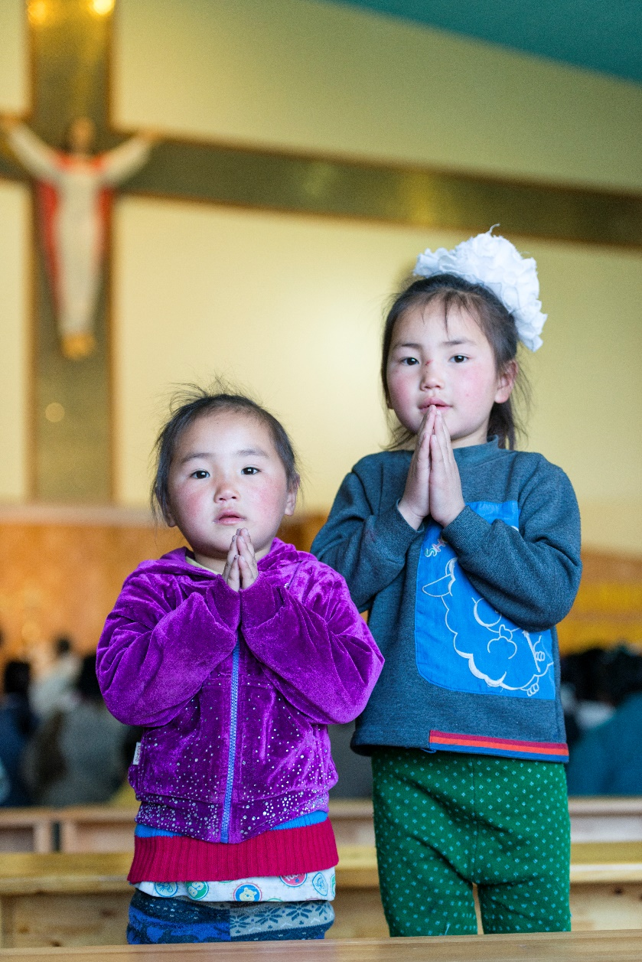
The Stations of the Cross
Fourteenth Station: Jesus is laid in the tomb
‘There was in the place where he was crucified a garden, and in the garden a new tomb, in which no one had yet been laid. And so there… because the tomb was nearby, they laid Jesus .’ John 19:41-42
It is apt that Jesus’ tomb was located in a garden, a place where the cycle of death and new life is witnessed as the seasons pass. When they laid Jesus in the tomb, his followers had no idea of the new life that was beginning to rise; a life that would change all time.
Reflection: I am so used to seeing suffering and death in our world. The news appears to report nothing else. But the lesson of the cross teaches us to keep our eyes and hearts open for signs of new beginnings. God’s love and light are always at work, especially in the darkest times.
Prayer: Lord, open my eyes,
to notice beauty in the world,
kindness in people, love all around me,
and Your risen Son, everywhere.
The Catholic Church has only been present in Mongolia since 1991. Since then the Church, with help from Missio’s supporters, has grown and begun projects that care for Mongolia’s poor and vulnerable, like these two young girls.
Children at Mass, Mongolia

