Slide 1
Nobody,
no situation
and no place
is beyond God’s care

Slide 2
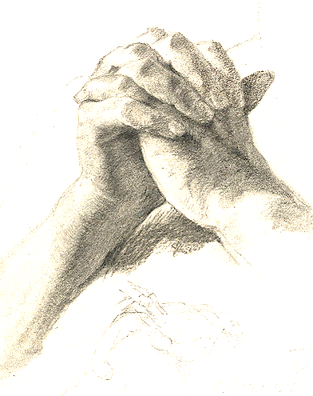
‘Jesus often went onto the mountain to pray; and he spent the whole night in prayer to God.’
Luke 5:16
‘Tefillah’
To join, to unite with

Slide 3
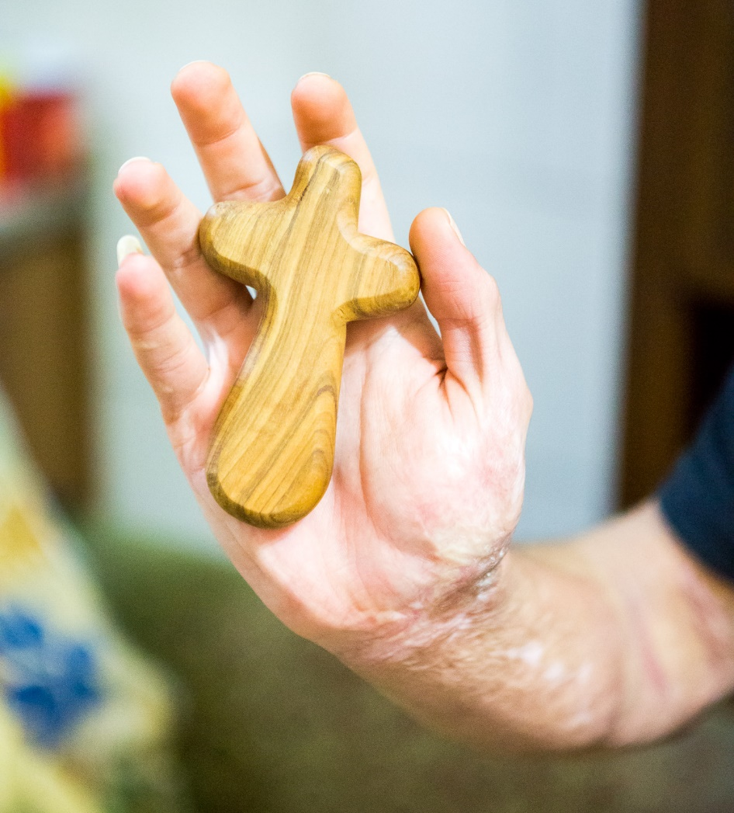
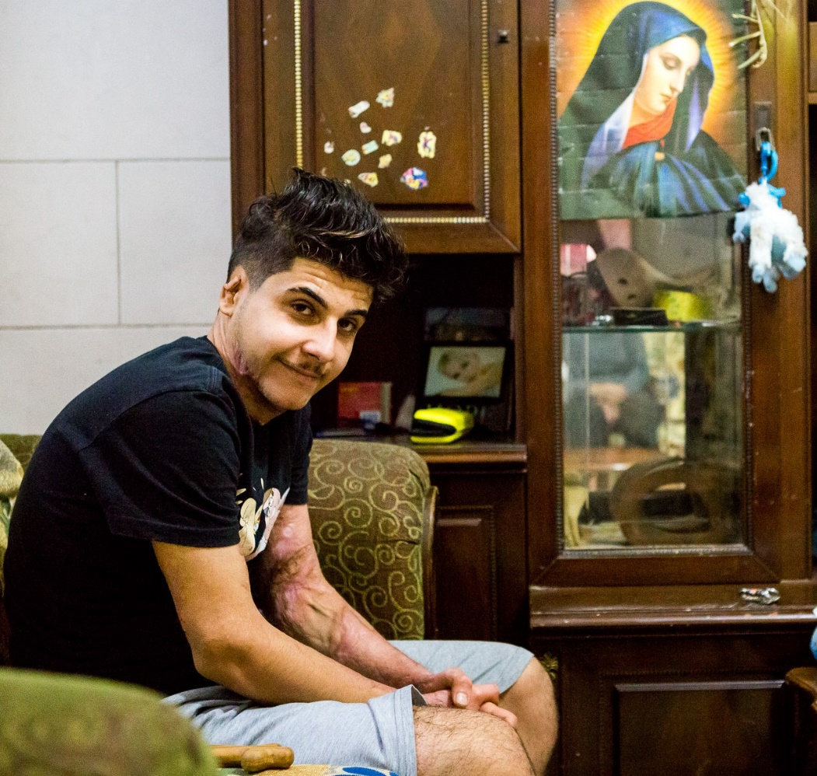
‘Tefillah’
To join, to unite with
Images ©Missio/TLouapre

Slide 4
Our Father, Who art in heaven Hallowed be Thy Name; Thy kingdom come, Thy will be done, on earth as it is in heaven. Give us this day our daily bread, and forgive us our trespasses, as we forgive those
who trespass against us; and lead us not into temptation, but deliver us from evil.
Amen.
Images ©Missio/TLouapre

Slide 5
Nobody,
no situation
and no place
is beyond God’s care

