Slide 1
No body,
no situation
and no place
is beyond God’s care

Slide 2
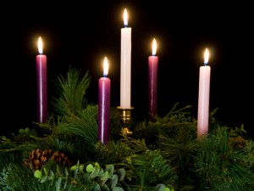

Slide 3
Advent Week Three – Joy
And Mary said:
‘My spirit rejoices
in God my Saviour,
for he has looked upon his servant
in her lowliness…
He has lifted up the poor.
He has filled the hungry
with good things.’
An Advent reading from the Gospel of St Luke 1:36-48, 51-55

Slide 4
‘Young people do not solely need material things.
They need to have values
which are the heart of people ... spirituality, generosity,
solidarity, perseverance,
brotherhood and joy.’
Pope Francis

Slide 5
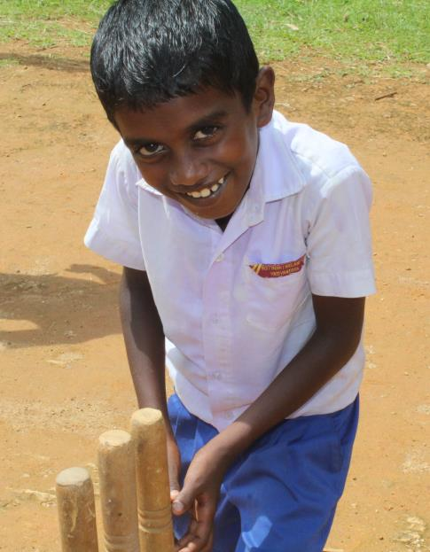
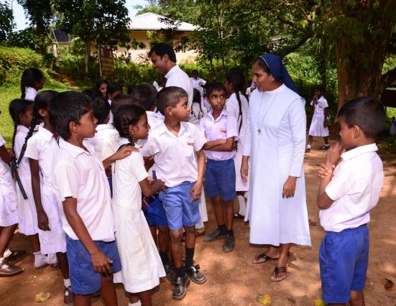

Slide 6
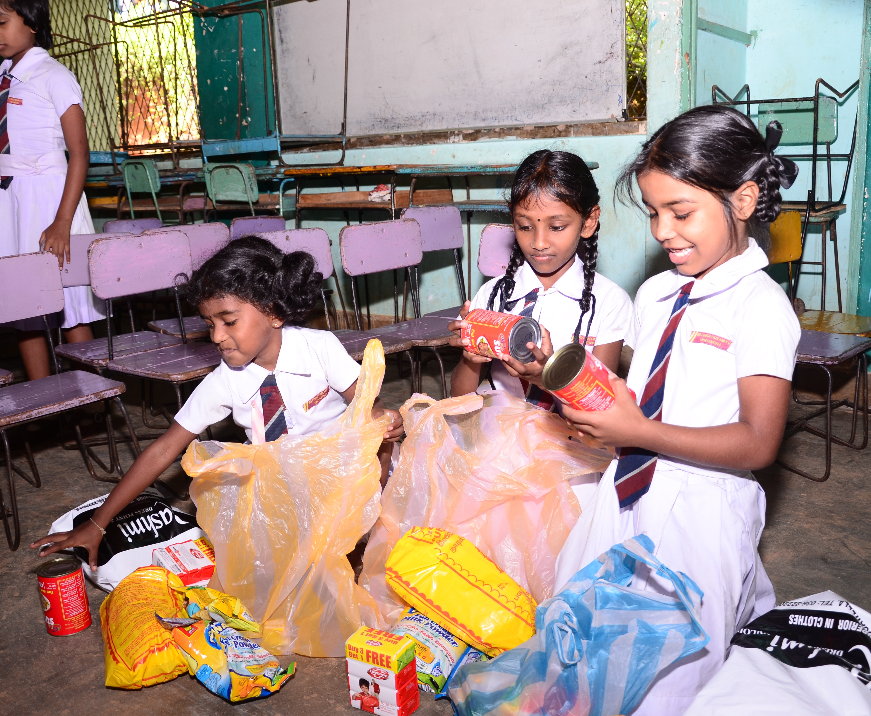

Slide 7
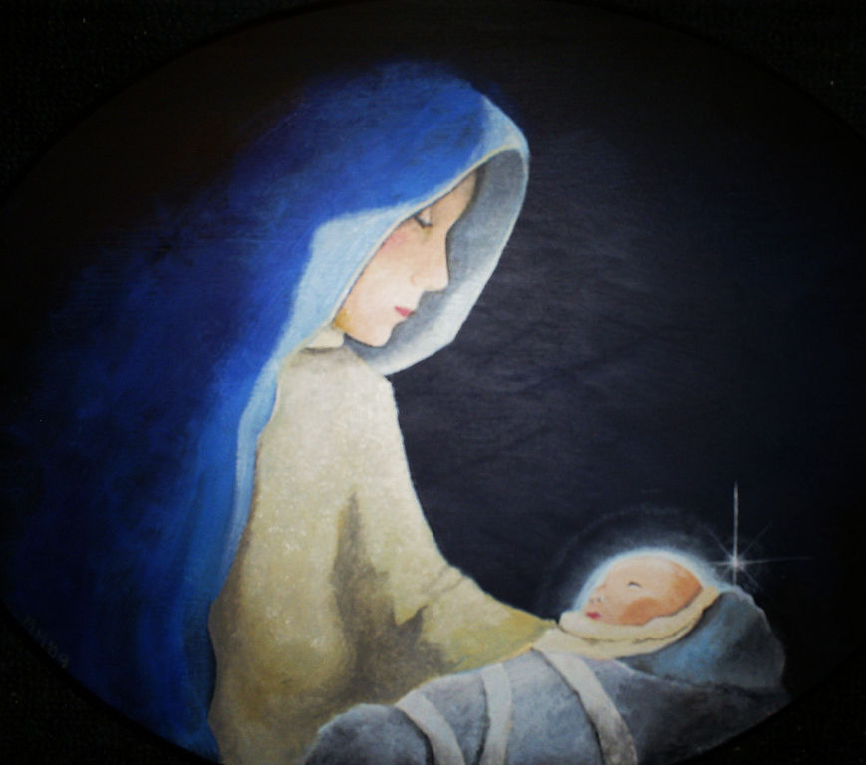
And Mary said:
‘My spirit rejoices
in God my Saviour,
for he has looked upon his servant
in her lowliness…
He has lifted up the poor.
He has filled the hungry
with good things.’

Slide 8
I give you my spirit
that you may pray
in me.
Above all,
I give you my heart
that you may love in me Your Father
and all humankind.
I give you my mind
that you may think
in me.
I give you my whole self that you may grow in me, so that it is you,
Lord Jesus,
who live
and work
and pray in me.
Lord Jesus,
I give you my hands
to build your Kingdom.
I give you my feet
to go your way.
I give you my tongue
to speak your words.

