Slide 1
Lent Assembly
Week Four
CST – Dignity of Work
Notes:
PLEASE DOWNLOAD AND PRINT ASSEMBLY NOTES at
http://www.missio.org.uk/lent-and-eastertide

Slide 2
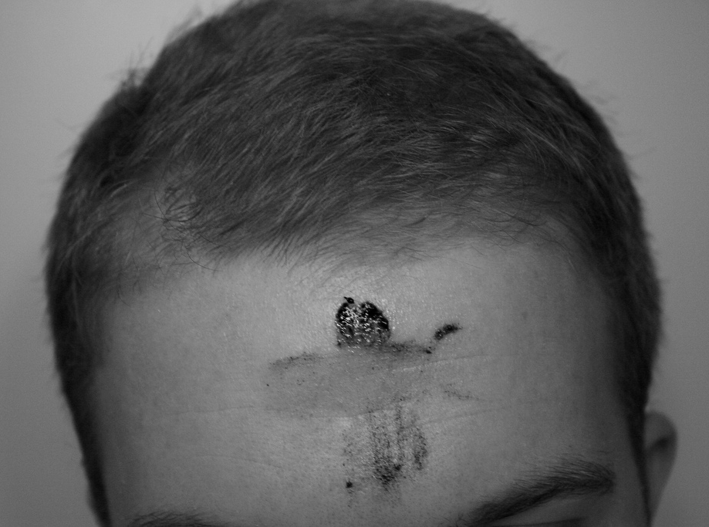
Lent – Week Four
Repent
Notes:
PLEASE DOWNLOAD AND PRINT ASSEMBLY NOTES at
http://www.missio.org.uk/lent-and-eastertide

Slide 3
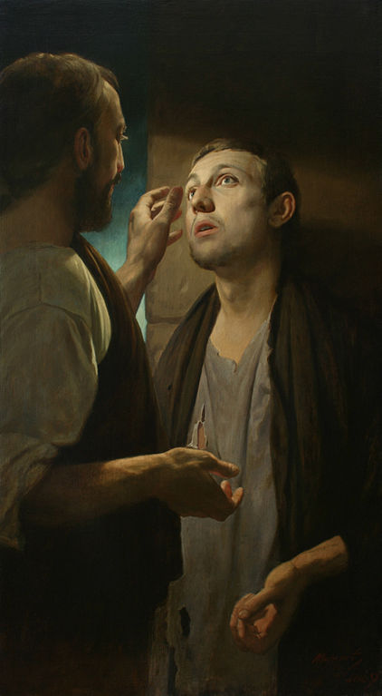
Lent – Week Four
Jesus then spat on the ground and made some mud; he rubbed the mud on the man's eyes and told him, ‘Go and wash in the Pool of Siloam.’
So the man went, washed his face, and came back seeing. His neighbours and the people who had seen him begging, asked, ‘Isn't this the man who used to beg?’
Some said, ‘He is the one.’ Others said, ‘No he just looks like him.’ So the man himself said, ‘I am he.’
Gospel of John 9: 1-3, 6-9
As Jesus was walking along, he saw a beggar who had been born blind. His disciples asked him, ‘Teacher, whose sin caused this? Was it his own or his parents' sin?’
Jesus answered, ‘His blindness has nothing to do with his sins or his parents' sins. He is blind so that God's power might be seen at work in him.’
Notes:
PLEASE DOWNLOAD AND PRINT ASSEMBLY NOTES at
http://www.missio.org.uk/lent-and-eastertide

Slide 4
Lent – Week Four
Human Dignity
Care of Creation
Catholic Social Teaching
Community
Dignity of Work
Option for the Poor
Solidarity
Notes:
PLEASE DOWNLOAD AND PRINT ASSEMBLY NOTES at
http://www.missio.org.uk/lent-and-eastertide

Slide 5
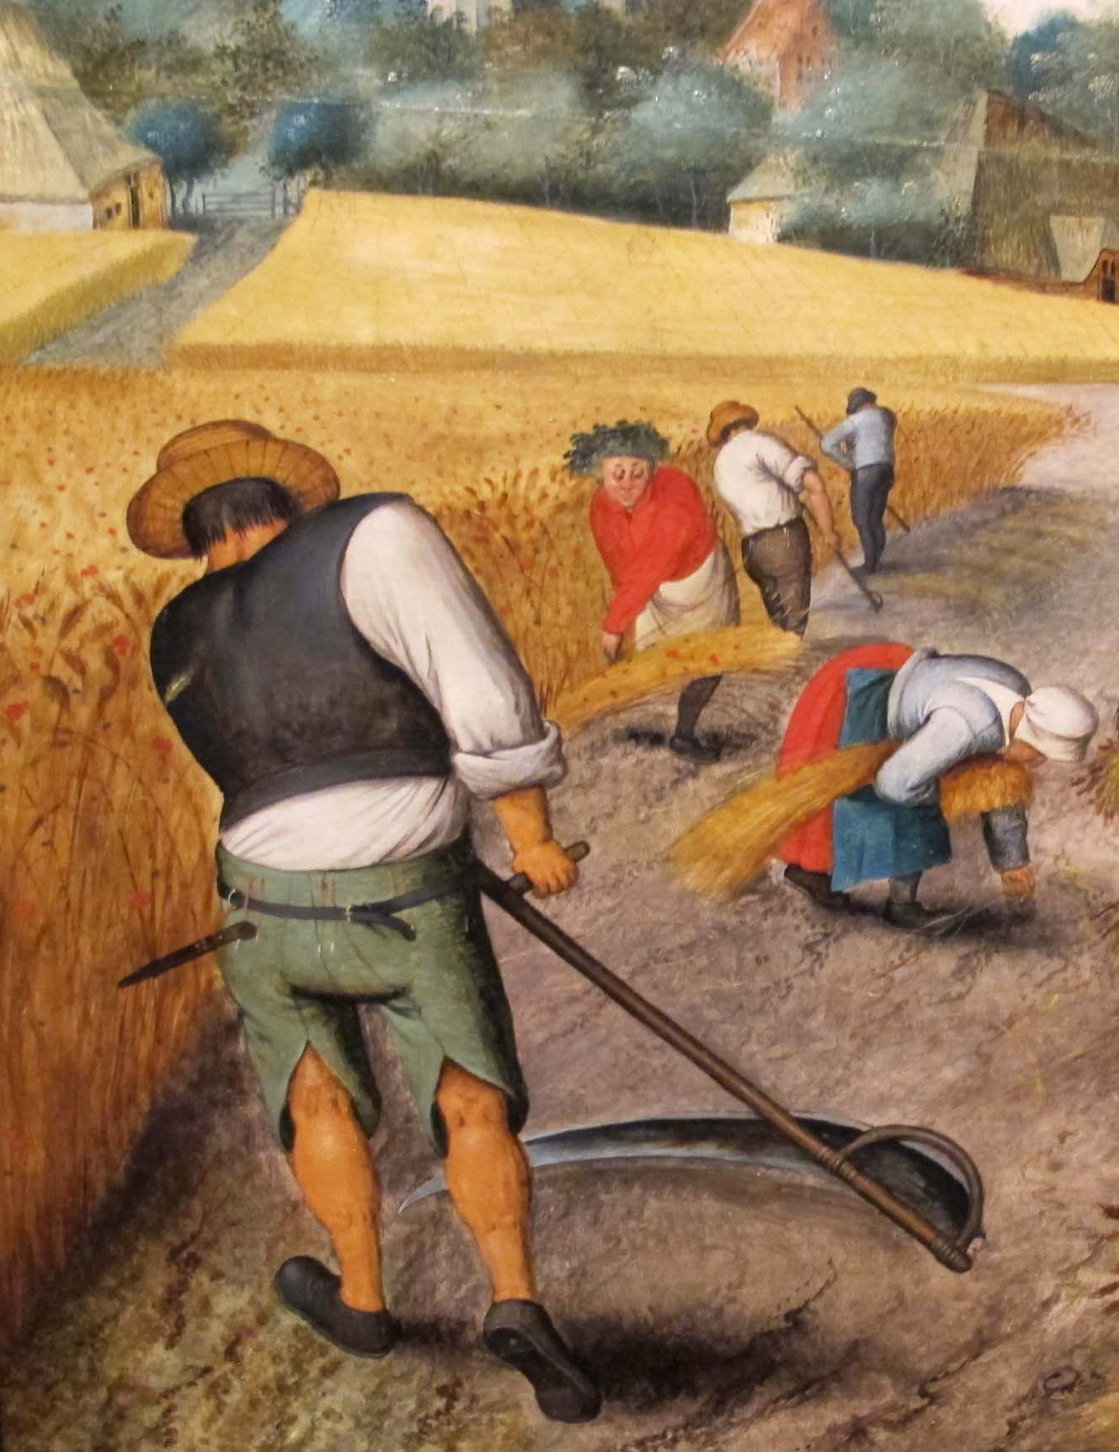
Lent – Week Four
Dignity of Work
Notes:
PLEASE DOWNLOAD AND PRINT ASSEMBLY NOTES at
http://www.missio.org.uk/lent-and-eastertide

Slide 6
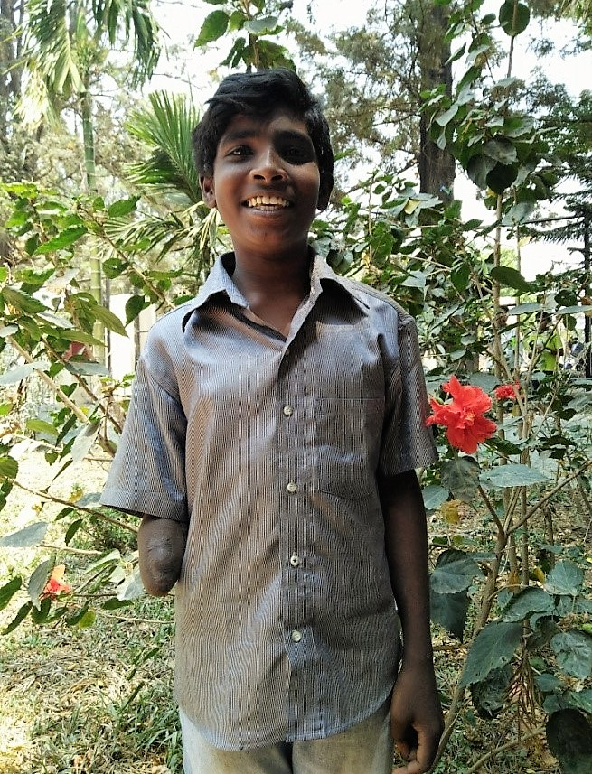
Lent – Week Four
Dignity of Work
Notes:
PLEASE DOWNLOAD AND PRINT ASSEMBLY NOTES at
http://www.missio.org.uk/lent-and-eastertide

Slide 7
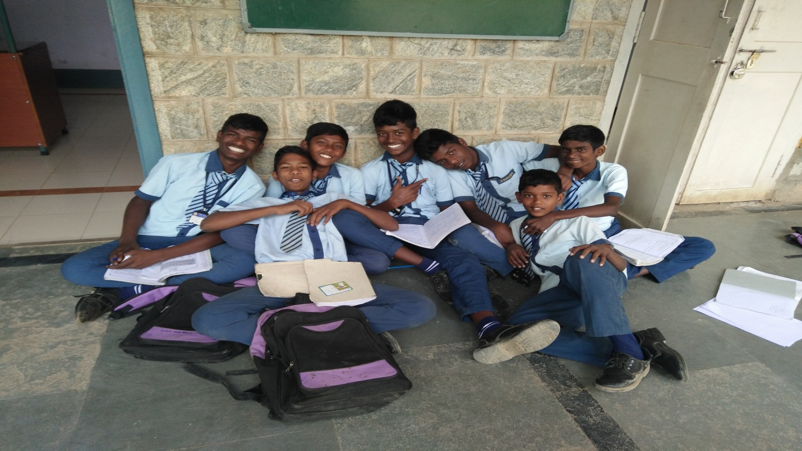
Lent – Week Four
FASTING
Serve the server
CHARITY
Chores for charity
PRAYER
For work and workers
Notes:
PLEASE DOWNLOAD AND PRINT ASSEMBLY NOTES at
http://www.missio.org.uk/lent-and-eastertide

Slide 8
Lent – Week Four
Lord, you look with love upon us in our work,
Whether a pupil, a cleaner, a builder, a teacher.
All our efforts to better our lives and our world
are pleasing to you.
You had your own particular work to do,
To share your love with the world.
Help us to make this our life’s work too.
To be missionaries of God’s love.
Amen
Notes:
PLEASE DOWNLOAD AND PRINT ASSEMBLY NOTES at
http://www.missio.org.uk/lent-and-eastertide

Slide 9
No body,
no situation
and no place
is beyond God’s care.
Notes:
PLEASE DOWNLOAD AND PRINT ASSEMBLY NOTES at
http://www.missio.org.uk/lent-and-eastertide

