Slide 1
Lent Assembly
Week One
CST – Solidarity
Notes:
PLEASE DOWNLOAD AND PRINT ASSEMBLY NOTES at
http://www.missio.org.uk/lent-and-eastertide

Slide 2
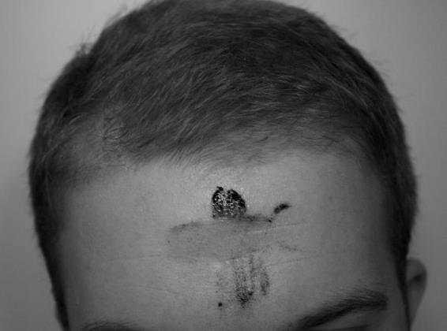
Lent – Week One
Repent
Notes:
PLEASE DOWNLOAD AND PRINT ASSEMBLY NOTES at
http://www.missio.org.uk/lent-and-eastertide

Slide 3
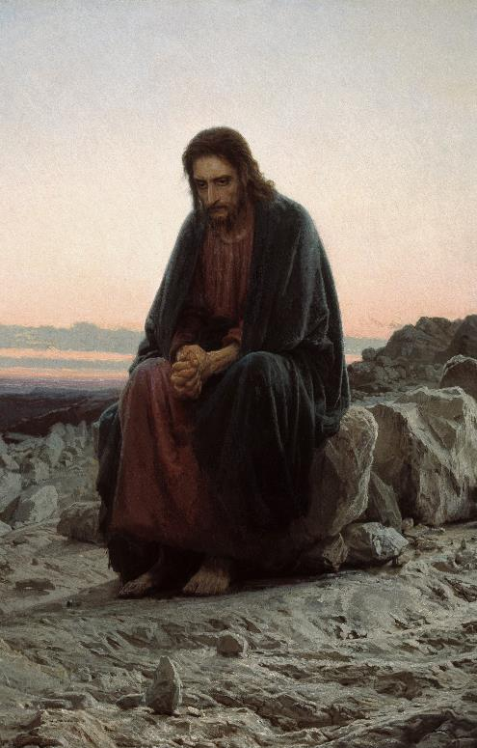
Lent – Week One
‘Jump off and prove you are the Son of God; for scripture says, “God will keep you from harm.”’ Jesus replied, ‘It also says not to put the Lord to a foolish test!’
Next Satan showed him the nations of the world and all their glory and said, ‘I’ll give you power over all this if you will only kneel and worship me.’
‘Get out of here Satan,’ Jesus told him. ‘The scriptures say, “Worship only the Lord God. Follow only him.”’
Gospel of Matthew 4: 1-10
Jesus was led out into the wilderness by the Holy Spirit, to be tested by Satan. For forty days and nights he ate nothing and became very hungry.
Then Satan tempted him to change stones into bread. ‘It will prove you are the Son of God,’ he said.
But Jesus told him, ‘No! For the scriptures tell us that bread won’t feed men’s souls: the word of God is what nourishes life.’
Then Satan took Jesus to the roof of the Temple and said to him:
Notes:
PLEASE DOWNLOAD AND PRINT ASSEMBLY NOTES at
http://www.missio.org.uk/lent-and-eastertide

Slide 4
Lent – Week One
Human Dignity
Care of Creation
Catholic Social Teaching
Community
Dignity of Work
Option for the Poor
Solidarity
Notes:
PLEASE DOWNLOAD AND PRINT ASSEMBLY NOTES at
http://www.missio.org.uk/lent-and-eastertide

Slide 5
Lent – Week One
Solidarity
Notes:
PLEASE DOWNLOAD AND PRINT ASSEMBLY NOTES at
http://www.missio.org.uk/lent-and-eastertide

Slide 6
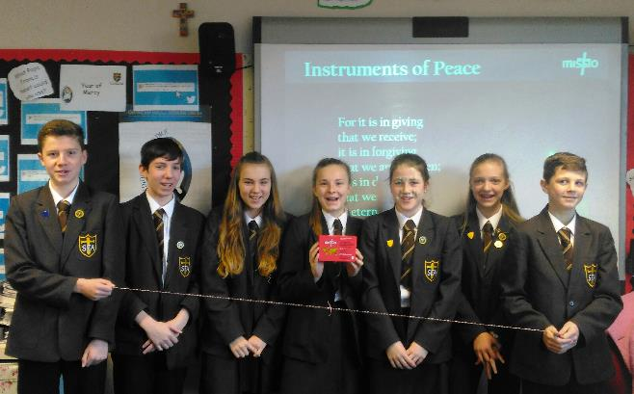
Lent – Week One
Notes:
PLEASE DOWNLOAD AND PRINT ASSEMBLY NOTES at
http://www.missio.org.uk/lent-and-eastertide

Slide 7
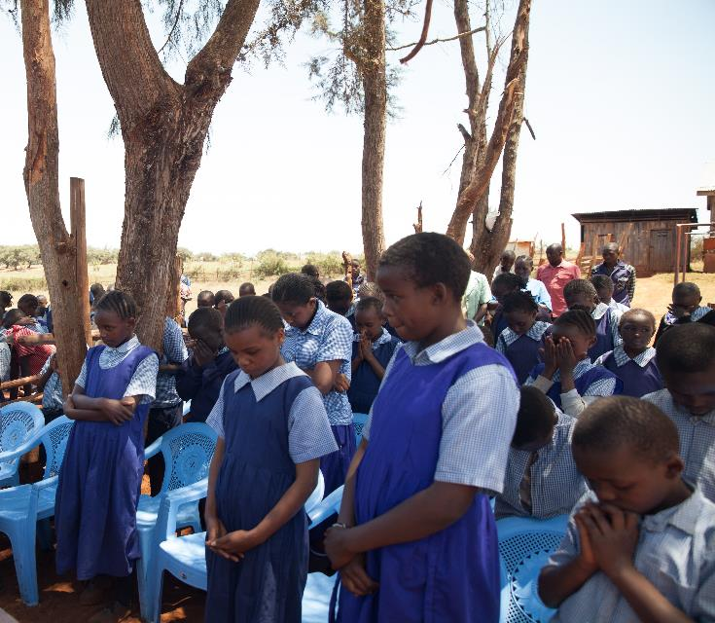
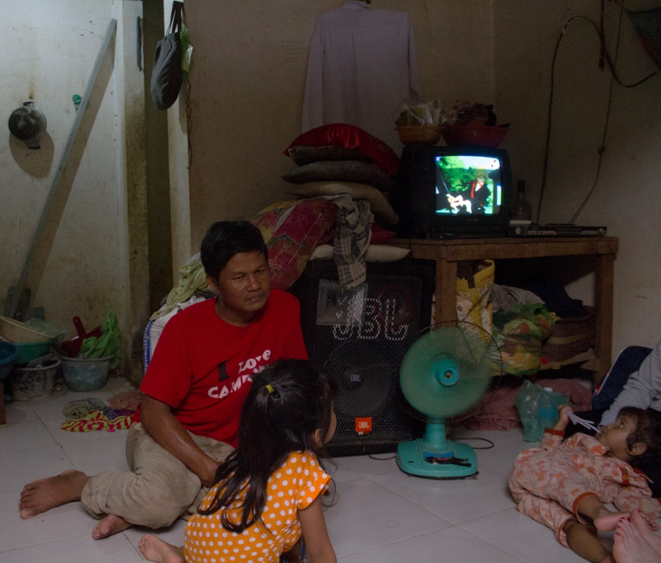
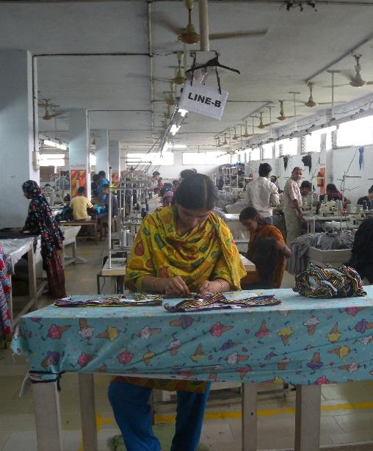
Lent – Week One
Notes:
PLEASE DOWNLOAD AND PRINT ASSEMBLY NOTES at
http://www.missio.org.uk/lent-and-eastertide

Slide 8
Lent – Week One
God has created me to do Him some definite service. He has committed some work to me which He has not committed to another.
I have my mission. I am a link in a chain, a bond of connection between persons. He has not created me for nothing.
I shall do good; I shall do His work. I shall be an angel of peace, a preacher of truth in my own place, while not intending it, if I do but keep His commandments.
Therefore, I will trust Him, whatever I am, I can never be thrown away.
The Mission of My Life – a prayer by Blessed John Henry Newman (adapted)
Notes:
PLEASE DOWNLOAD AND PRINT ASSEMBLY NOTES at
http://www.missio.org.uk/lent-and-eastertide

Slide 9
No body,
no situation
and no place
is beyond God’s care.
Notes:
PLEASE DOWNLOAD AND PRINT ASSEMBLY NOTES at
http://www.missio.org.uk/lent-and-eastertide

