Slide 1
No body,
no situation
and no place
is beyond God’s care.

Slide 2
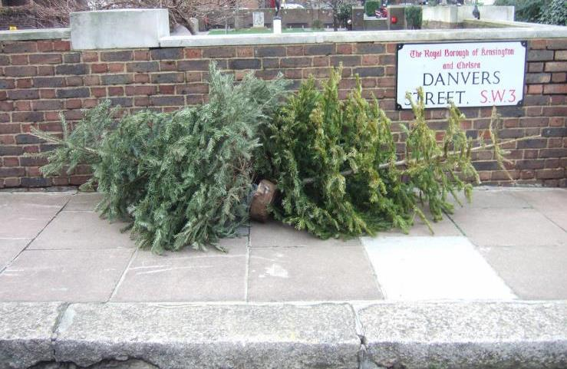
Christmas is over. Or is it?

Slide 3
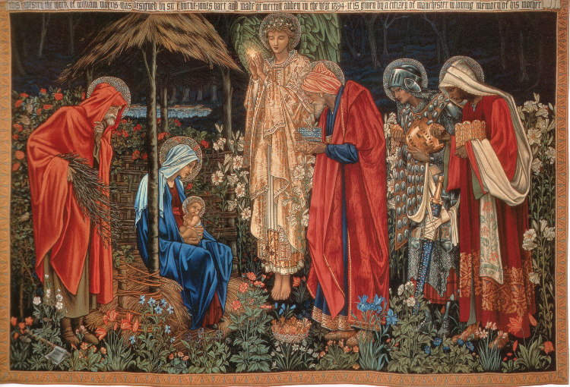
The Epiphany of the Lord
The Magi’s arrival
Gifts of gold, frankincense, and myrrh
Following a bright star.

Slide 4
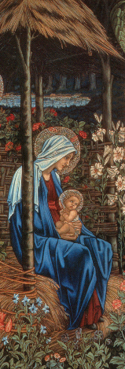
New ways of seeing

Slide 5
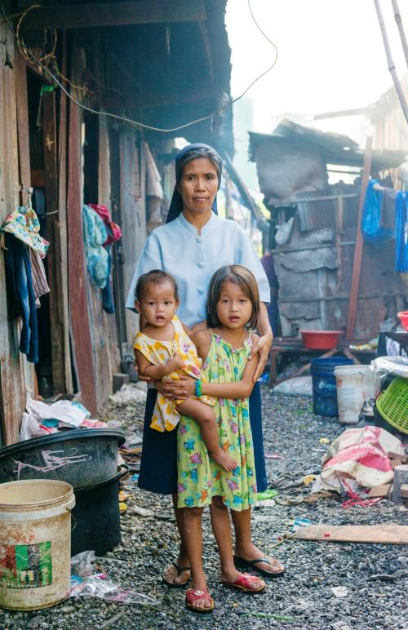
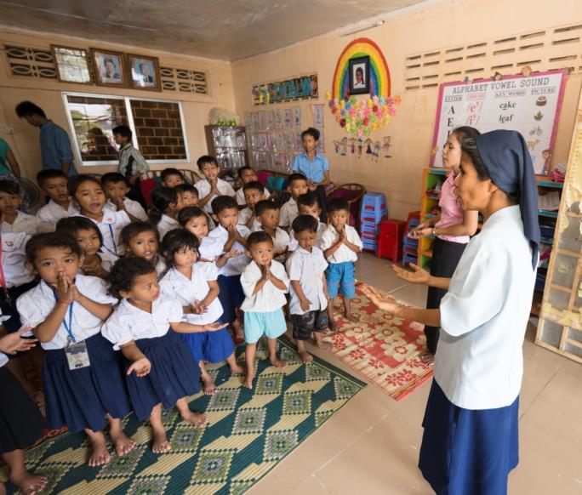
Reaching out to help

Slide 6
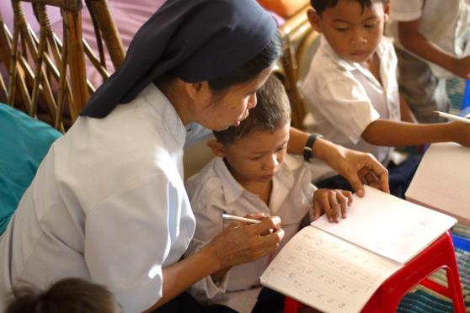
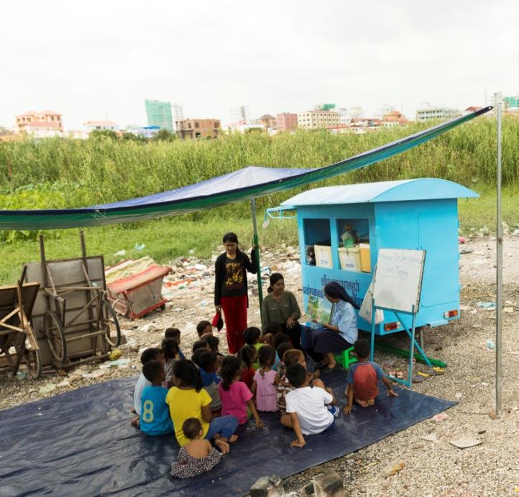
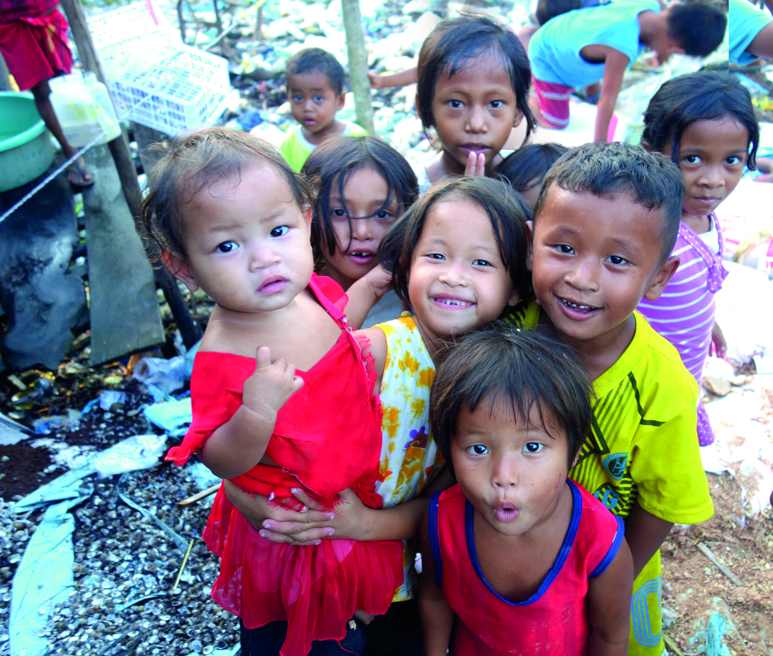
Reaching out to help
“In all the settings in which you find yourselves,
God’s love invites you to bring the Good News, making of your own lives a gift to him and to others.” Pope Francis

Slide 7
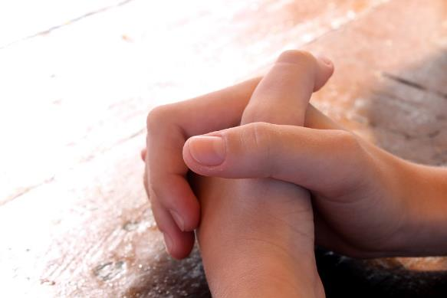
Pray and Share

Slide 8
When Herod heard this, he was disturbed, and all the people of Jerusalem with him. He sent the Magi off to Bethlehem, saying, ‘When you find the little child, report to me.’
The Magi set off, and the star that they had seen in the east led them on.
A reading from the Gospel of St Matthew Chapter 2
After Jesus was born in Bethlehem in Judea, during the time of King Herod, Magi from the east came and asked, ‘Where is the one who has been born king of the Jews? We saw his star and have come to worship him.’
The star stood above the place where the little child was. The Magi came and saw him, with Mary his mother, and they fell down and worshipped him.
And they opened their treasures and offered him their gifts.
The Gospel of the Lord.

