Slide 1
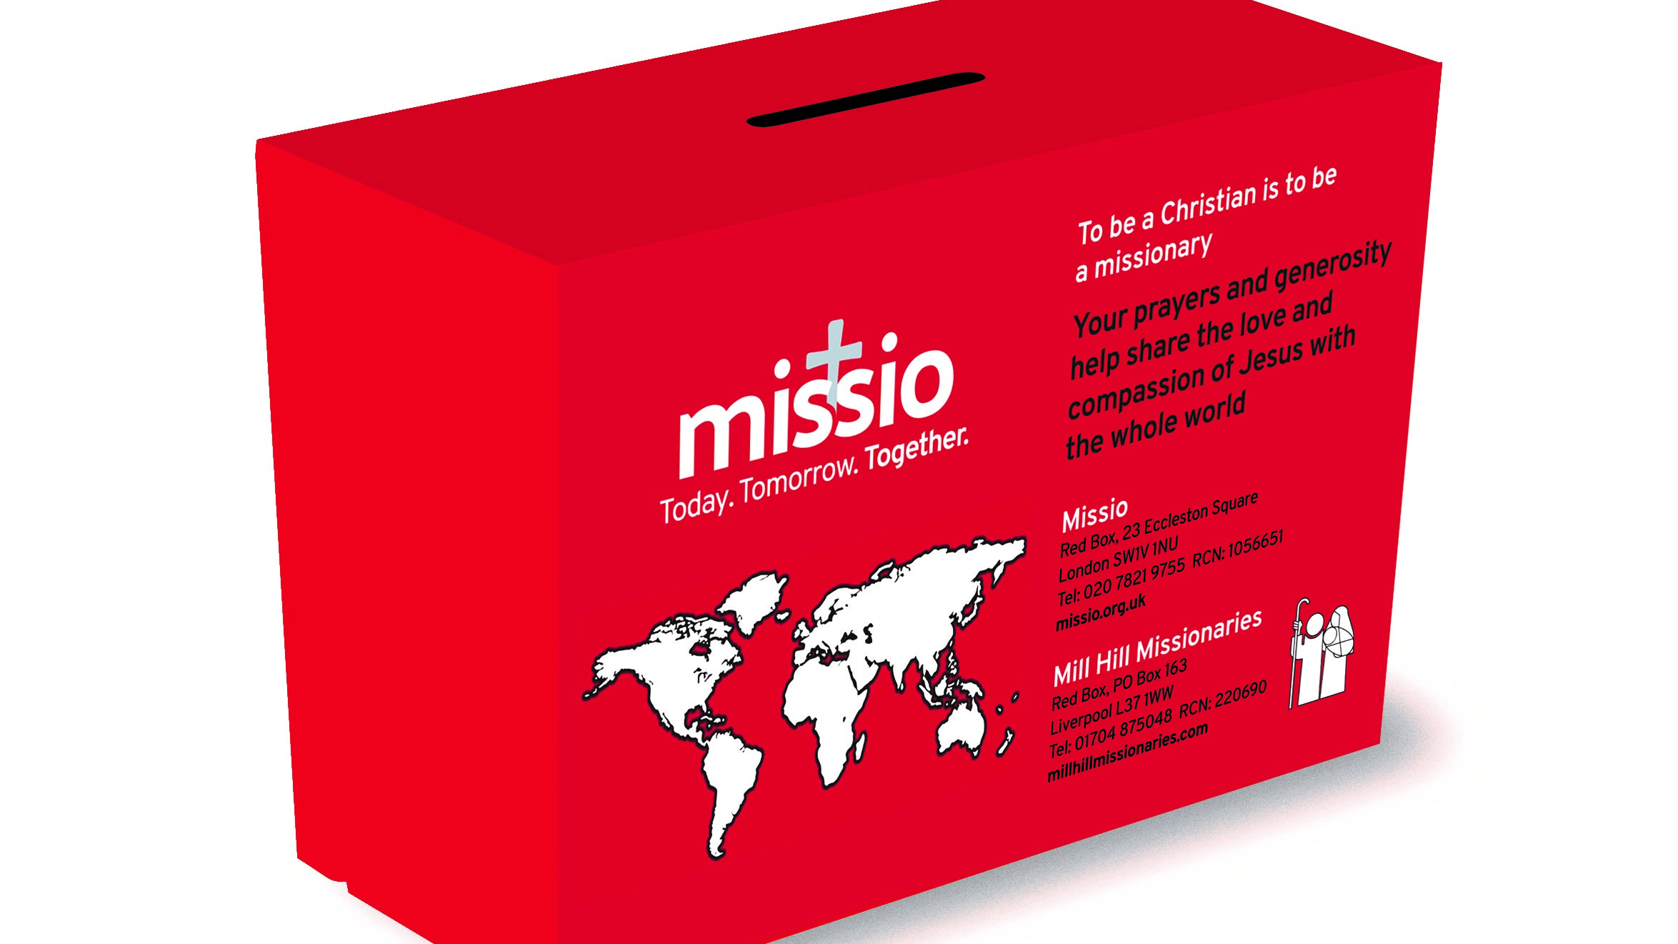
Local Secretaries consultation 2020/21

Slide 2
Why embark on a consultation?
COVID-19 has accelerated changes in parishes, the way we all communicate with one another, and our use of cash.
With less cash being used, the traditional role of the Local Secretary in coordinating the counting of money in Red Boxes and ensuring it is banked will become less necessary.

Slide 3
Contributors
Local Secretaries
Diocesan Directors
Mill Hill Appealers
Appeal Coordinators from Maidenhead & Freshfield
Parish Priests
Missio staff

Slide 4
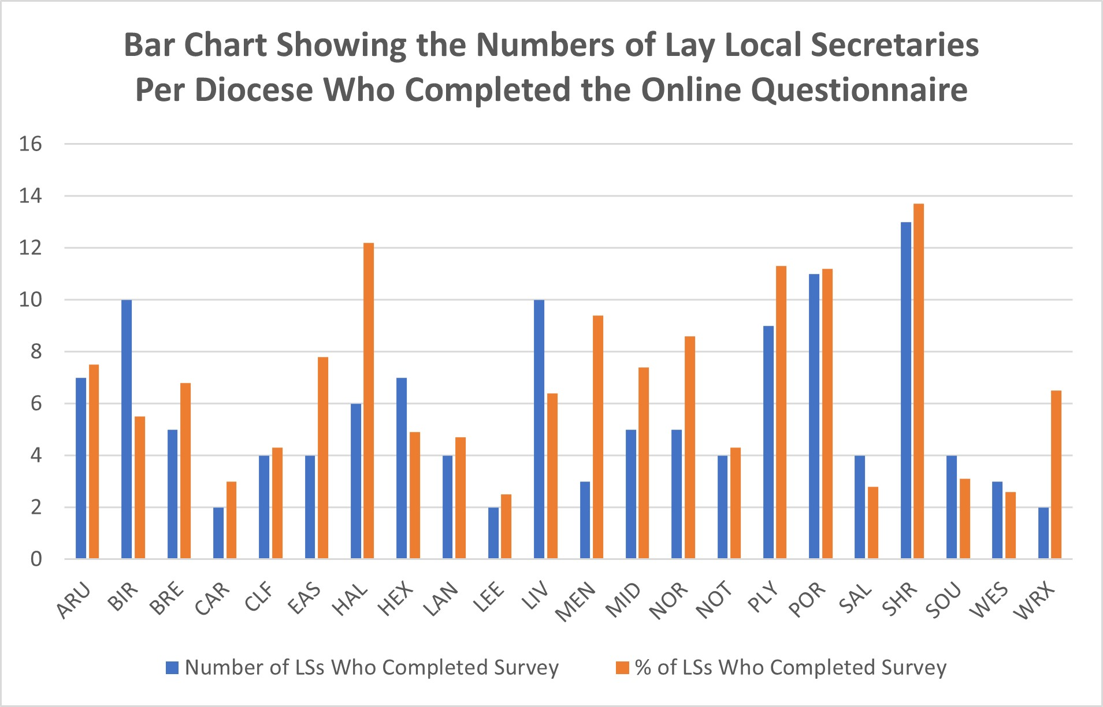

Slide 5
What we are hearing

Slide 6
Positive messages
Local Secretaries are positive about wanting to be involved in this change.
Many Local Secretaries want to be reignited in their role/ministry, having been involved for a long time. They are unsure about how to move forward and welcome our support.
Overall very positive, with a love for what they do, even if often they got into the role accidentally.
Our role in a post-pandemic Church: enabling community to be re-established; online reflections and training helping to inspire.
Our work in the last twelve months has been appreciated!

Slide 7
“We need to inspire Local Secretaries to recruit and reignite their own Mission and the Mission outlook of the parish. I have been reignited by the online reflections which have really helped during the pandemic.” LS in Southwark Diocese
“As we have developed more digital means of communication during lock down I have been able to use these to pass on digital information, such as the online reflections.” LS in Hallam Diocese

Slide 8
Challenges
The burden people feel, with many unsure who (if anyone) will take on the role when they retire.
Possible opportunity: recruit for a different sort of role?
Parish priests often not good at recruiting volunteers, or don’t have time/capacity to do this.
Handing on to younger generations (not school age, but young families).
Engaging priests, helping them to see the value of Missio and our work for their own parish communities. Ongoing formation of priests, etc..
Continuing to communicate about Missio simply, and the range of resources we have to offer.

Slide 9
“Most of my Red Box holders are very elderly so we need to attract younger people and young families. We need to be moving towards Direct Debits for the younger generations.” LS in Portsmouth Diocese
“ The generations after mine are happy, I think, to support foreign development or aid, but much less likely to see financial support for the spread of the Faith as a priority.” MHM

Slide 10
Areas to develop

Slide 11
Promotional material
Training & Formation
Processes
(Internal & External)
Communication
Structure
(Parish clusters,
Ls & promoters)
Community

Slide 12
Potential working groups
Cashless giving
Encouraging direct giving, contactless payments etc
The role of the Local Secretary
Promotion & awareness raising
Role descriptions & recruitment
Training and Formation
Resources
It is envisaged that the working groups will consist of Local Secretaries from across England & Wales, the Regional Community Fundraisers and other Missio staff members, Mill Hill Appealers, and Diocesan Directors.

Slide 13
Local Secretaries consultation 2020/21

