Slide 1
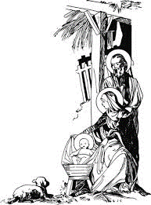
‘In the beginning was the Word:
and the Word was with God
and the Word was God.
He was with God in the beginning.
Through him all things came to be,
not one thing had its being but through him.
All that came to be had life in him,
and that life was the light of men;
a light that shines in the dark,
a light that darkness could not overpower.
The Word was made flesh,
he lived among us,
and we saw his glory,
the glory that is his as the only Son of the Father,
full of grace and truth.’
John 1:1-5,14
Cherish God’s written word.
Listen to the readings at Mass and read the scriptures yourself, reflect on them, look for the truth they contain and let the word shape who you are.
Cherish the relationship Jesus was born to form with you.
Spend time with him in prayer, communicating with God through your words, your emotions, yourself.
Cherish your body and those of others.
Don’t devalue the one you have or that of another. Treat both with respect and love.
Find ways to share God’s message of love with others.
Visit someone who is lonely. Share with someone in need. Pray for someone who is sick.

