Slide 1
Catholic Social Teaching:
Community and Participation

Slide 2
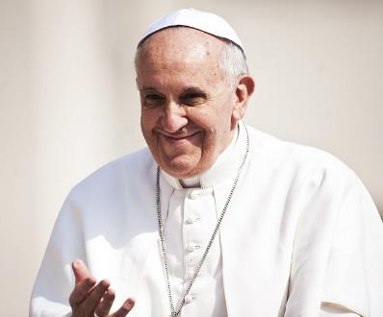
‘Be dreamers [who] believe in a new humanity, one that rejects hatred between peoples, one that refuses to see borders as barriers.’
Pope Francis

Slide 3
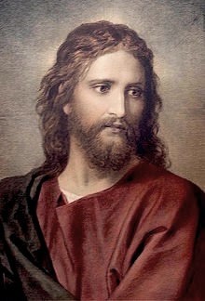
Some people came carrying a paralysed man on a stretcher, and they tried to put him in front of Jesus. Because of the crowd they could find no way to take him into the house.
So they carried him up on the roof, made an opening in the tiles, and let him down into the middle of the group in front of Jesus.
When Jesus saw how much faith they had, he said to the man, ‘Your sins are forgiven, my friend… get up, pick up your bed, and go home!’
Gospel of Luke 5:18-24

Slide 4
Human Dignity
Care of Creation
Catholic Social Teaching
Community and Participation
Dignity of Work
Solidarity

Slide 5
Community & Participation
‘Young people, don’t be observers of life, get involved.
Immerse yourself in the reality of life as Jesus did.’
Pope Francis

Slide 6
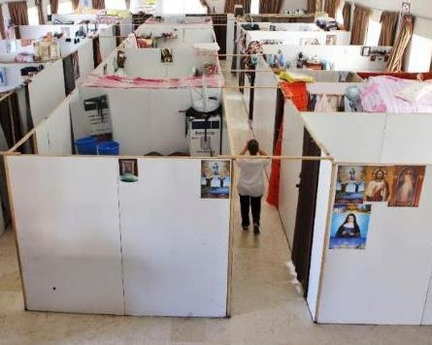
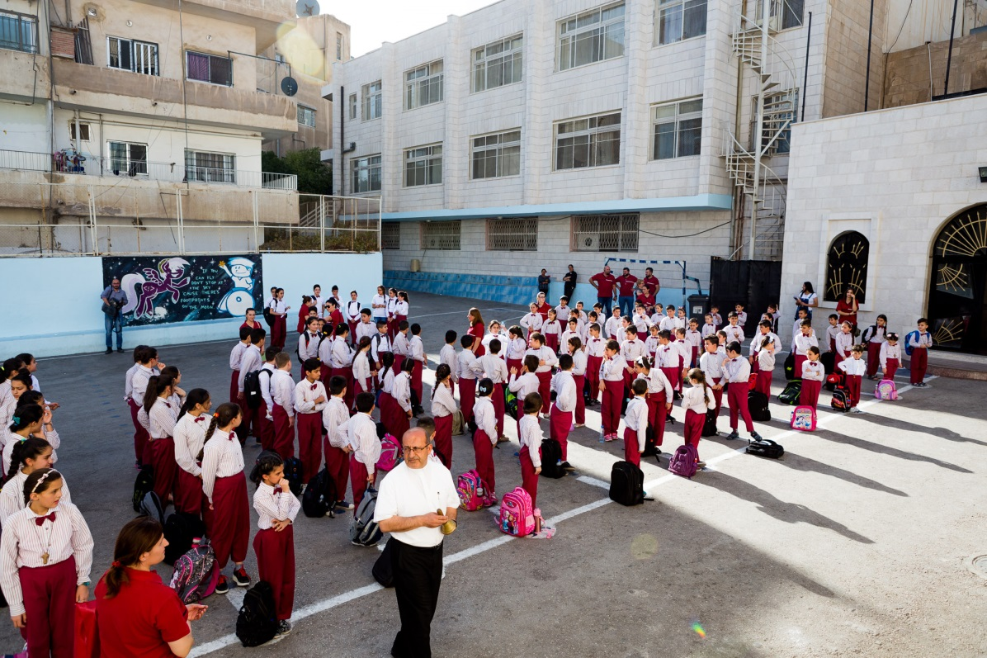
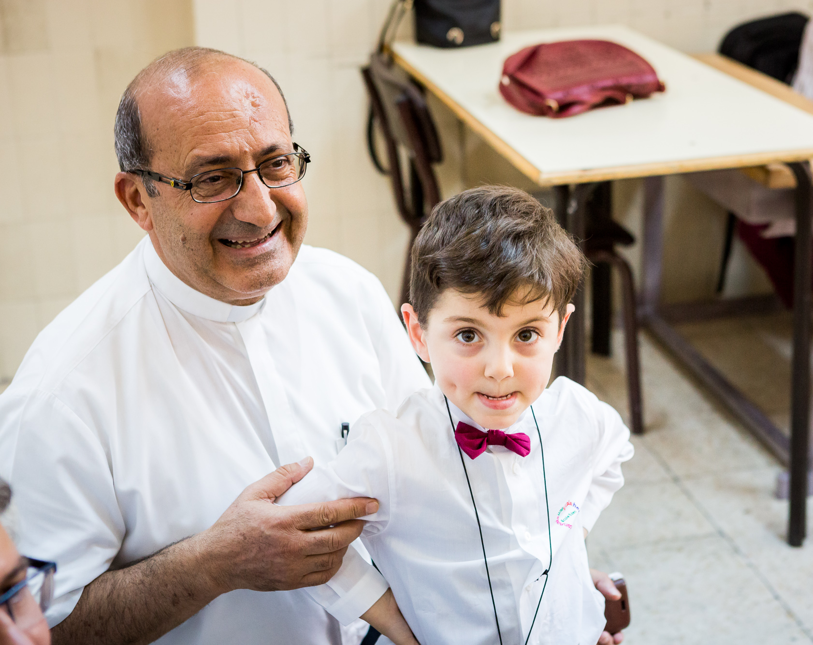
Community & Participation
Fr Khalil and the
Marka School for Refugees

Slide 7
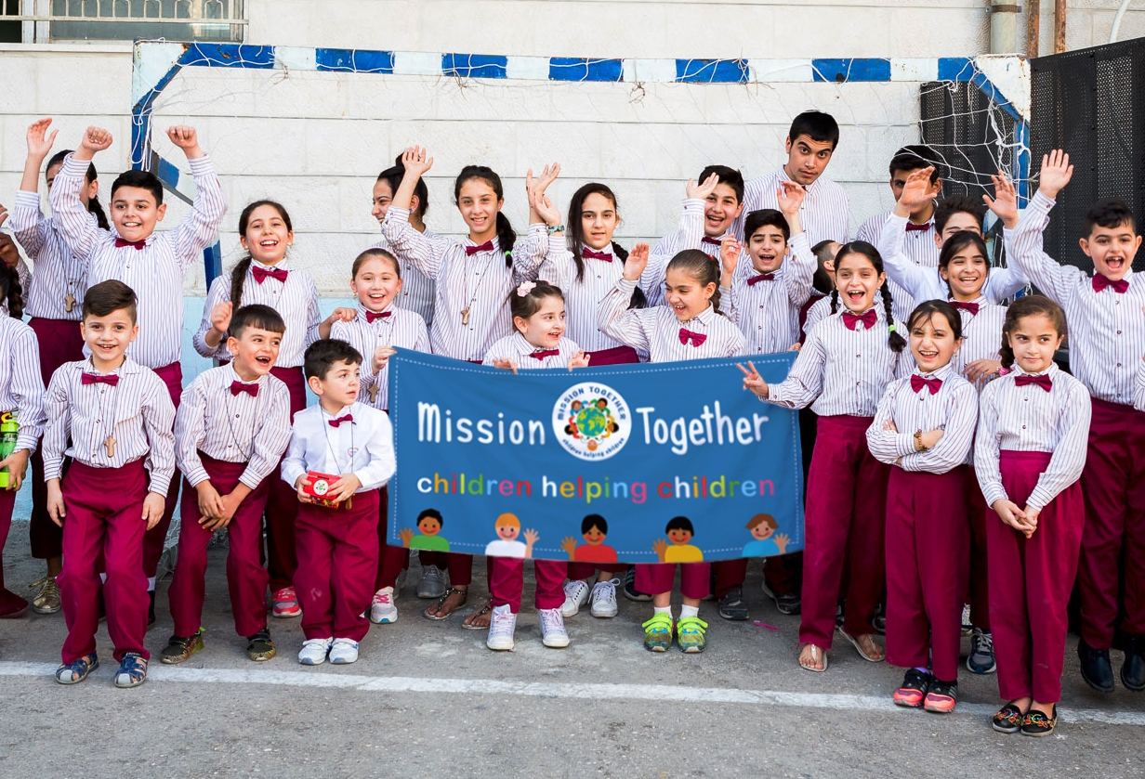
Call to Action: Chose to participate
Call to Action: Cakes and choirs
Call to Action: Commit to reading the Gospel

Slide 8
God help us to build community, To deepen our friendship and compassion, Especially for the forgotten and the lonely.
God help us to build unity and peace, With other peoples, religions and nations. Bind us together with your love and joy.
Help us to follow your Son's words and actions, To do all we can to build your kingdom of justice and mercy.
We make this prayer through Christ, Your Son.
Amen

Slide 9
Nobody,
no situation
and no place
is beyond God’s care

