Slide 1
Nobody,
no situation
and no place
is beyond God’s care.

Slide 2
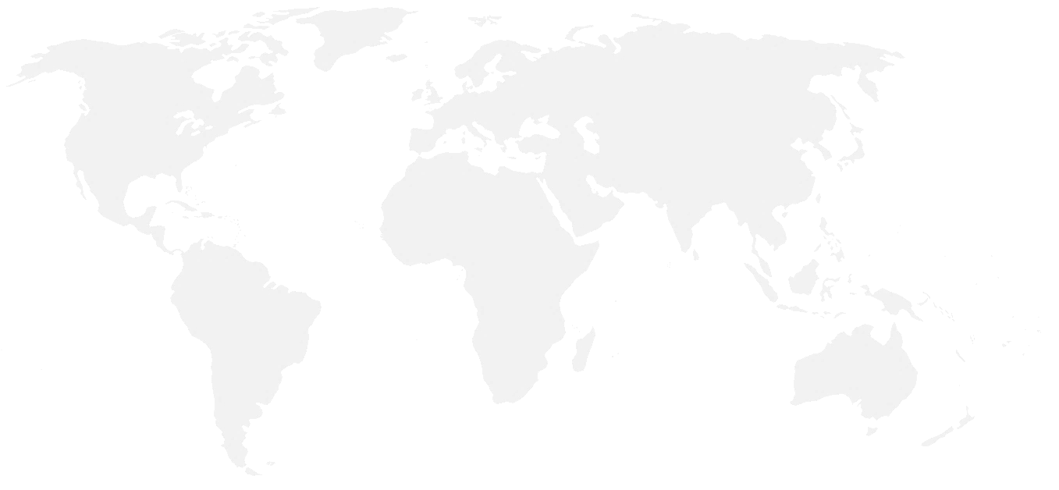
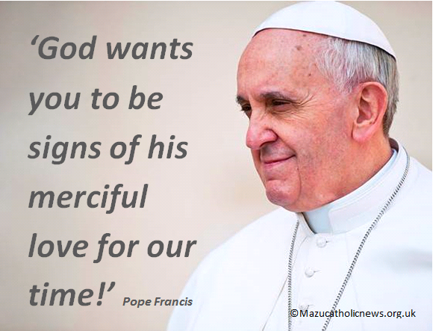
Mercy
Being kind, compassionate,
and forgiving;
most notably towards those who have caused offence.
A willingness to help anyone in need.
Notes:
In December 2015 Pope Francis invited all people, not just Catholics, to focus on the urgent need for mercy in our own lives and in the world. This special Jubilee Year of Mercy concludes on 20 November 2016, but the call to be merciful remains constant. This was made clear in a speech Pope Francis made during this year’s World Youth Day. To all young people the Pope made this appeal… click to reveal
‘God wants you to be signs of his merciful love for our time!’
The message of mercy is so important to Pope Francis and the Church because quite simply it was so important to Jesus who, as Christians, we believe is God made man. In Jesus’ words, in some of his most famous parables (e.g. The Prodigal Son), and in his example, Jesus taught that our lives and the life of the world is made better when we act with mercy.
It’s a view shared also by Muslims, whose holy book the Qur’an begins almost every chapter with the words ‘In the name of God, the All-merciful, the Ever-merciful.’
For Christians, Muslims, Jews, and followers of other world religions, to act with mercy is fundamental way in which we imitate God. Just to be clear about what mercy means, let’s remind ourselves with this definition… click to reveal.
Mercy - Being kind, compassionate, and forgiving; most notably towards enemies and those who have caused offence. It is a willingness to help anyone in need.
When we consider this definition of mercy, it’s clear that Jesus is setting us a massive challenge. To be merciful, as God desires, is at times the complete opposite to what we feel like doing inside, and it’s definitely not the message we hear around us.

Slide 3
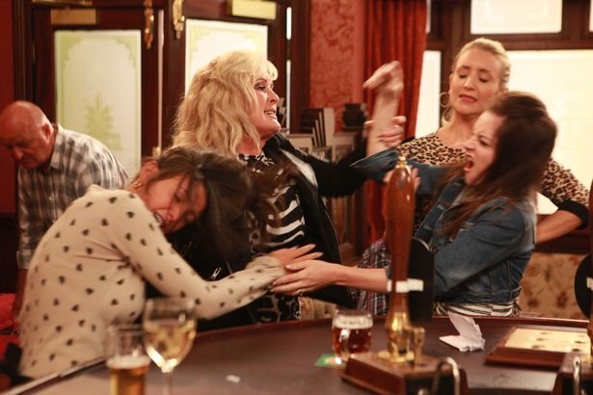
Jesus said, ‘Love your enemies, do good to them… Be merciful, just as your Father is merciful.’ Luke 6:35-36

Slide 4
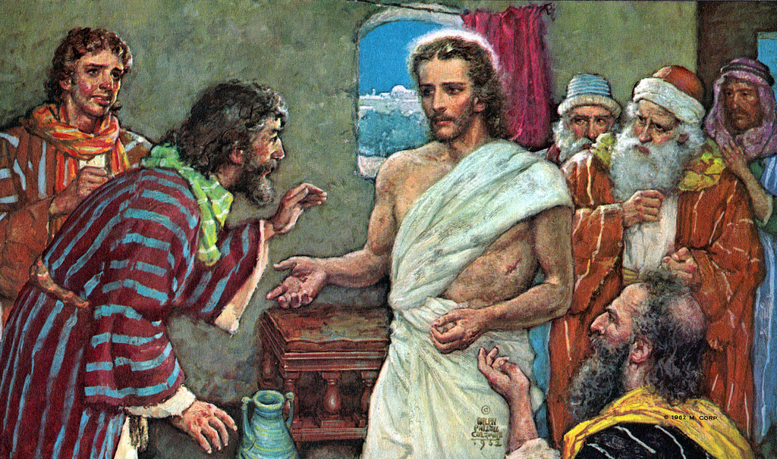
Reconciliation
To bring back together, people torn apart by differences and offenses.

Slide 5
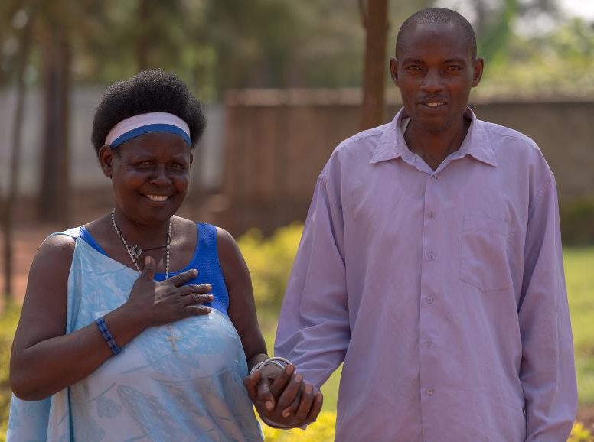
Genocide: The deliberate killing of a large group of people, especially those of a particular nation or ethnic group.
Notes:
This is Concilie (far left) and her neighbour, Paschal. They live in Rwanda, a country in Africa (indicated on the map). Has anyone heard of Rwanda and if so what can they tell us about it?
In 1994, when Paschal was around the same age as you, Rwanda was plunged into genocide. For those who are unsure about what this means, here’s a definition… click to reveal.
Genocide - The deliberate killing of a large group of people, especially those of a particular nation or ethnic group.
Rwanda’s genocide was particularly ugly because it was a genocide in which friends, neighbours, even members of the same family attacked and killed one another. It was also especially violent – in the course of just 100 days between April and July 1994, around one million people were massacred.
Rwanda’s genocide followed years of tension between the country’s two main ethnic groups – Hutu and Tutsi.
The Tutsis were the smallest group, but in the past they’d held most of Rwanda’s money and power. The Hutus for many years felt that they were second-class citizens and not treated fairly, and over the years this sense of injustice bubbled over into a deep resentment towards the Tutsis. Even when power and money began to be shared more equally, and these two groups were studying, working, and living together, the Hutus still mistrusted the Tutsis.
Undercurrents of resentment and prejudice are always dangerous. That’s why we need to challenge our own thinking and that of others whenever a person or group is rubbished simply because of their background, beliefs, or lifestyle.
In Rwanda, nobody challenged this prejudice. In fact, some influential Hutus in authority who were keen to stir division encouraged hatred towards the Tutsis. By using the media and spreading rumours that went unchallenged, they whipped up bad feeling until it tipped over into violence.

Slide 6
Jesus said, ‘Love your enemies, do good to them…
Be merciful, just as your Father is merciful.’ Luke 6:35-36
Notes:
This is Concilie (far left) and her neighbour, Paschal. They live in Rwanda, a country in Africa (indicated on the map). Has anyone heard of Rwanda and if so what can they tell us about it?
In 1994, when Paschal was around the same age as you, Rwanda was plunged into genocide. For those who are unsure about what this means, here’s a definition… click to reveal.
Genocide - The deliberate killing of a large group of people, especially those of a particular nation or ethnic group.
Rwanda’s genocide was particularly ugly because it was a genocide in which friends, neighbours, even members of the same family attacked and killed one another. It was also especially violent – in the course of just 100 days between April and July 1994, around one million people were massacred.
Rwanda’s genocide followed years of tension between the country’s two main ethnic groups – Hutu and Tutsi.
The Tutsis were the smallest group, but in the past they’d held most of Rwanda’s money and power. The Hutus for many years felt that they were second-class citizens and not treated fairly, and over the years this sense of injustice bubbled over into a deep resentment towards the Tutsis. Even when power and money began to be shared more equally, and these two groups were studying, working, and living together, the Hutus still mistrusted the Tutsis.
Undercurrents of resentment and prejudice are always dangerous. That’s why we need to challenge our own thinking and that of others whenever a person or group is rubbished simply because of their background, beliefs, or lifestyle.
In Rwanda, nobody challenged this prejudice. In fact, some influential Hutus in authority who were keen to stir division encouraged hatred towards the Tutsis. By using the media and spreading rumours that went unchallenged, they whipped up bad feeling until it tipped over into violence.

Slide 7
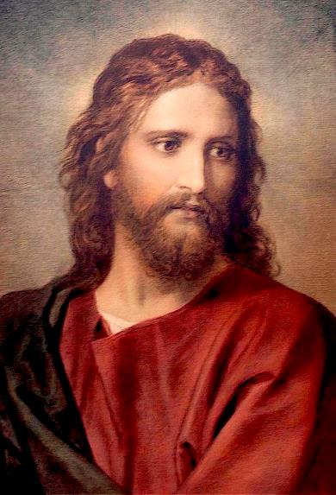
Our Father, who art in heaven,
Hallowed be thy Name.
Thy Kingdom come.
Thy will be done on earth,
As it is in heaven.
Give us this day our daily bread.
And forgive us our trespasses,
As we forgive those who trespass against us.
Do not let us fall into temptation,
And deliver us from evil.
Amen.
Be a support to those struggling in your school community and parish.
Use your lives to communicate the message of mercy.
Support Missio’s work, through sharing what we can, and through prayer.
‘God wants you to be signs of his merciful love for our time!’
Pope Francis
Notes:
Concile and Paschal’s story illustrates well what happened.
Concile (on the left) is a Hutu and before 1994, was happily married to a Tutsi. Together they had eleven children. Paschal (on the right) also a Hutu, was a close neighbour. Living next to one another, their lives were bound up together, but that bond was brutally cut in the first few days of the genocide.
* If time allows use Broken Bonds Activity here, to illustrate this division. Instructions for the activity are at the end of this slide’s notes.
For weeks Paschal along with other local Hutu teenagers had been encouraged to think the worst of the Tutsi’s. Few questioned or challenged this thinking, which meant that when the fighting broke out across Rwanda, Paschal and his friends were easily stirred up by older Hutus, who supplied them with drugs and drink before sending them out to attack Tutsi homes and families. When Paschal and his gang reached Concile’s home they beat her, but as she was a Hutu, didn’t kill her. But they did kill her Tutsi husband and their eleven children.
The photo you can see on screen is of Concile and Paschal today. I’m sure you are wondering how they can they stand together like that, smiling and holding hands? But a lot has happened in between then and now.
Paschal, like thousands of other young men who took part in the killings, was sent to prison after the genocide and has only recently been released. This was important. Crimes need to be paid for, otherwise justice is lacking. But justice must go hand in hand with mercy. Prisoners must be given opportunities to ask and receive forgiveness too.
For Concile, the years after the genocide were filled with pain. Although before the killings she’d prayed and attended Mass, she’d not done so after the genocide. Tired and worn down with carrying the heavy weight of anger and bitterness, she came to understand that she could not let go of her hurt without God’s grace. So, one day, seeking guidance, she picked up her Bible and read the following words from the Gospel of Luke… Click to reveal.
Love your enemies, do good to them… Be merciful, just as your Father is merciful.
What would these words make you think? How would you feel if you read them? How do you think they made Concile feel?
Concile understood that in these words, Jesus was teaching us that only through mercy can we be free to live with courage and hope. She realised that she had been allowing her enemies to control who she was, but with God’s grace she could let go of her hurt and move on with life. This was never going to be easy. She would need the support of others to restore her sense of peace.
Broken Bonds Activity – part one:
You will need a long stretch of thin rope, between 4-6 meters.
A pair of scissors.
Four willing volunteers
Before the assembly begins arrange for three students to stand at the front of the assembly space, slightly apart. Ask them to hold the rope aloft. Explain to the whole student body that the rope is a symbol for the values that binds people together.
Ask students what these values might be e.g. trust, cooperation, mercy.
After these values have been vocalised, ask a fourth student to cut the rope in between each rope bearer. This should mean two rope bearers are left holding one severed section and one student holding two severed sections.
Comment that it was quick and easy to cut this bond, as it is when harsh words and actions breaks the trust between peoples.
Explain also that whilst it is quick and easy to cut bonds, it can take much time and effort to restore them.
Ask the rope bearers to place their sections of rope on the floor and return to their seats. Having the students sit near the front of the assembly space would be preferable, as you will be asking them to step forward and retie the rope in a few minutes.

Slide 8
Nobody,
no situation
and no place
is beyond God’s care.

