Slide 1
Catholic Social Teaching: Solidarity

Slide 2
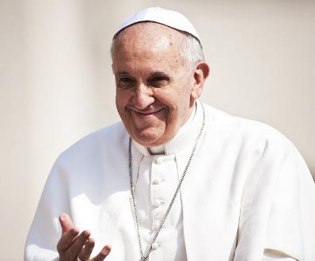
‘Christ has confidence in young people and entrusts them with his mission. Go create a world of brothers and sisters!’
Pope Francis

Slide 3
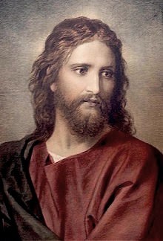
Christ is like a single body, which has many parts; it is still one body, even though it is made up of different parts.
The eye cannot say to the hand, “I don't need you!” Nor can the head say to the feet, “Well, I don't need you!”
There is no division in the body, but all its different parts have the same concern for one another. If one part of the body suffers, all the other parts suffer with it; if one part is praised, all the other parts share its happiness.
1 Corinthians 12:12-26 (abridged)

Slide 4
Human Dignity
Care of Creation
Catholic Social Teaching
Community and Participation
Dignity of Work
Solidarity

Slide 5
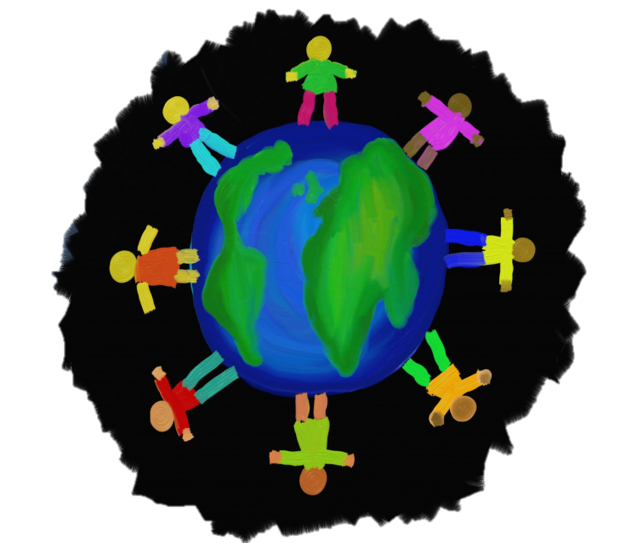
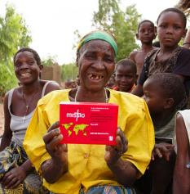
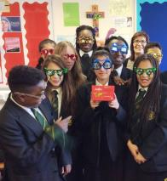
Solidarity
The Common Good - ‘the good of all human beings and the good of the whole human.’

Slide 6
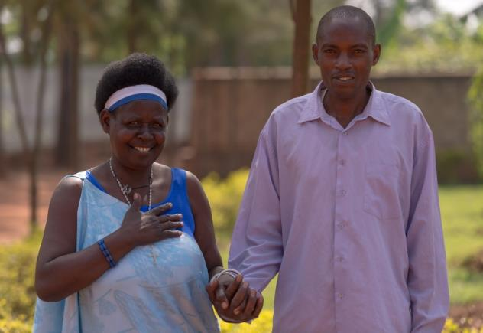
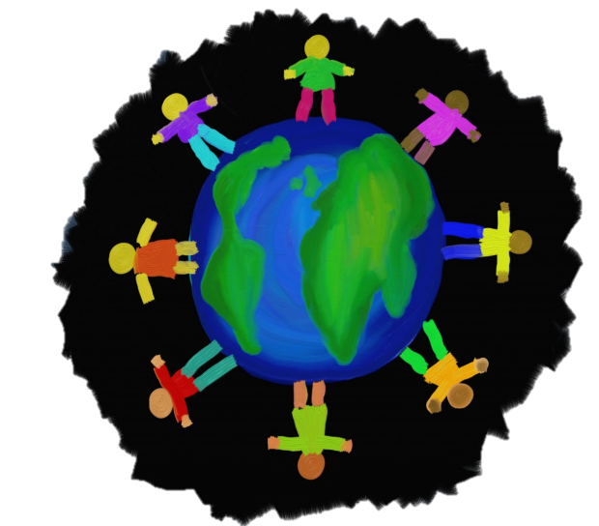
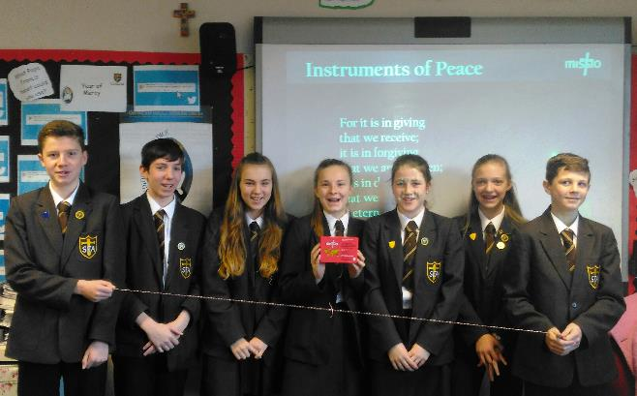

Slide 7
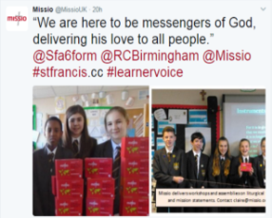
Call to Action: Reflect upon how you use social media
Call to Action: Consider how you could support Missio through sharing and prayer
Call to Action: Commit to reading the Gospel

Slide 8
God has created me to do Him some definite service. He has committed some work to me which He has not committed to another.
I have my mission. I am a link in a chain, a bond of connection between persons. He has not created me for nothing.
I shall do good; I shall do His work. I shall be an angel of peace, a preacher of truth in my own place, while not intending it, if I do but keep His commandments.
Therefore, I will trust Him, whatever I am, I can never be thrown away.
The Mission of My Life – a prayer by Blessed John Henry Newman (adapted)

Slide 9
Nobody,
no situation
and no place
is beyond God’s care

