Slide 1
Nobody,
no situation
and no place
is beyond God’s care

Slide 2
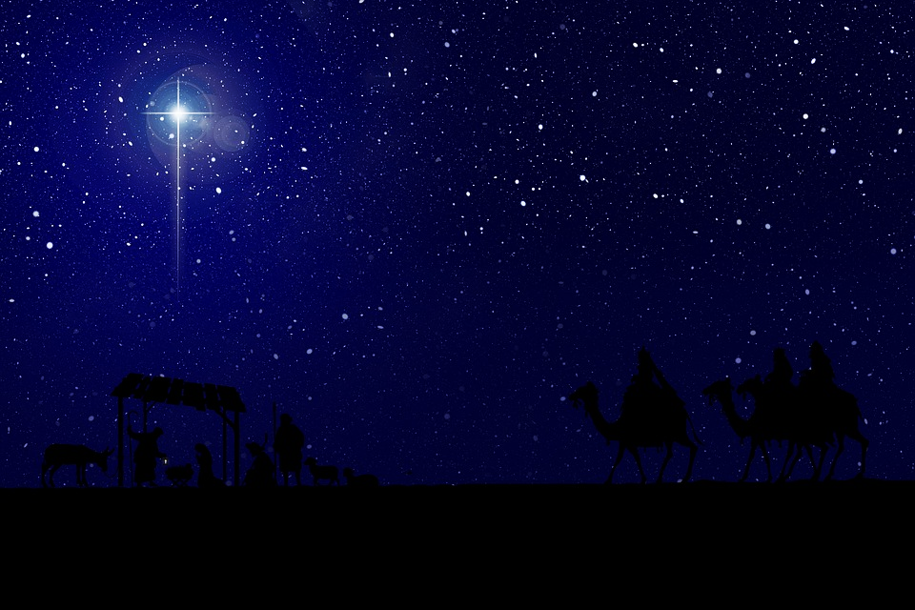
‘He rules the world with truth and grace,
And makes the nations prove
The glories of His righteousness,
And wonders of His love,
And wonders of His love,
And wonders, wonders, of His love.’

Slide 3
‘Now as soon as Elizabeth heard Mary’s greeting, the child leapt in her womb and Elizabeth was filled with the Holy Spirit. She gave a loud cry and said, ‘Of all women you are the most blessed, and blessed is the fruit of your womb. Why should I be honoured with a visit from the mother of my Lord? For the moment your greeting reached my ears, the child in my womb leapt for joy.’
Luke 1:41-44.’

Slide 4
Nobody,
no situation
and no place
is beyond God’s care

