Slide 1
Nobody,
no situation
and no place
is beyond God’s care

Slide 2
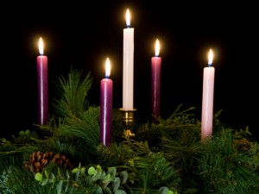

Slide 3
Advent Week One – Hope
You guide those who act with integrity
and keep your ways in mind.
Lord, you are our Father;
we the clay, you the potter,
we are all the work of your hand.
An Advent reading from the prophet Isaiah

Slide 4
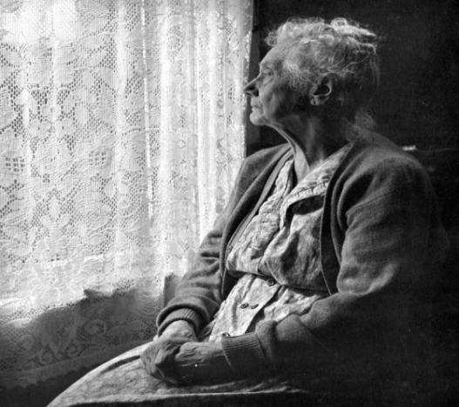
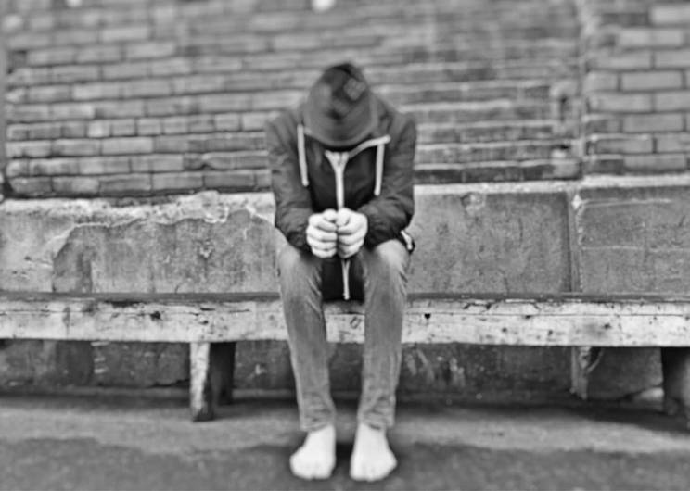
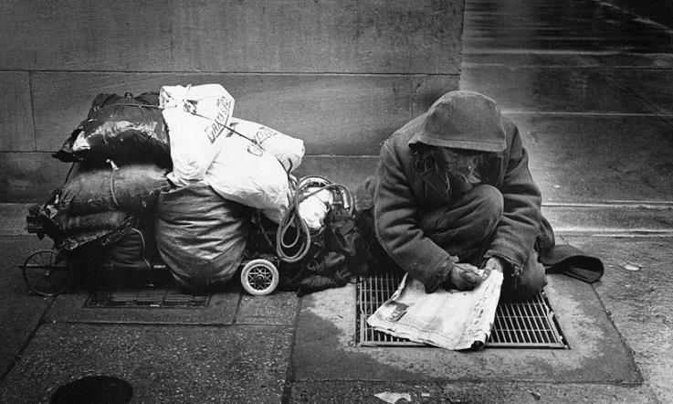
‘Do not let yourselves be robbed of hope!
Let us become bearers of hope!’ Pope Francis

Slide 5
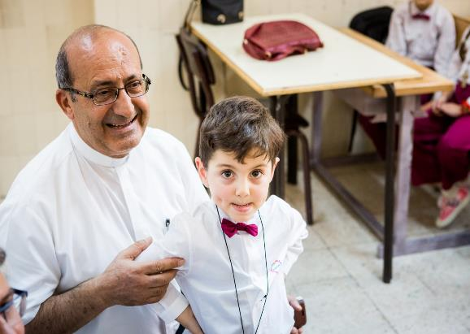
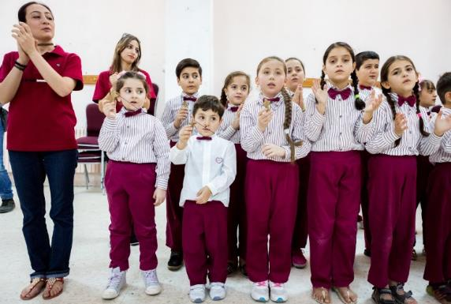
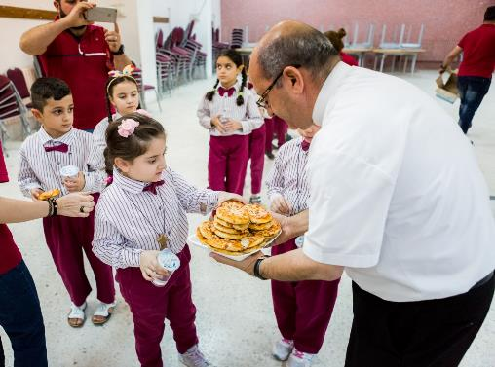
Jordan

Slide 6
Christ has no body now on earth,
but yours.
Yours are the eyes with which he looks with compassion on this world.
Yours are the hands,
Yours are the feet,
Yours are the eyes,
You are his body.
Yours are the hands, with which he blesses all the world.
Christ has no body but yours,
No hands, no feet on earth but yours.
Yours are the feet with which he walks to do good.

