Slide 1
Vocation Workshop
Called to be…

Slide 2
‘Whatever your vocation, I urge you: be brave, be generous and, above all, be joyful!’ Pope Francis

Slide 3
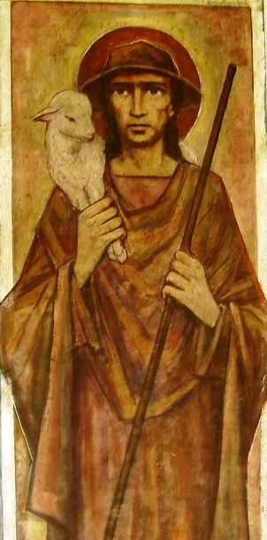
Vocation
Vox – voice
Vocare – to call
‘I am the Good Shepherd, I call each one by name.’ John 10:14

Slide 4
And the Lord said to me,
‘Don’t say “I am too young”;
You are to go to all those
to whom I send you,
And to speak to them as I direct you.
Do not be afraid before them,
for I am with you
to guide and protect.
Jeremiah 1:4-8

Slide 5
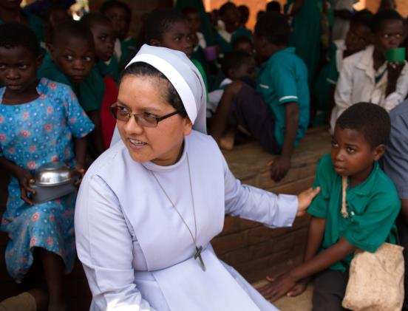
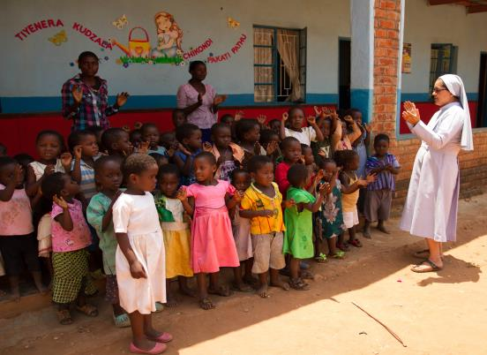
‘The Lord says, “I will teach you and guide you in the way you should live.’ Psalm 32: 8

Slide 6
‘God is also calling you,
he is looking at all the love
you are able to offer.
With your plans
and with your courage,
roads open up that lead
to a better, fairer,
less cruel world.’
Pope Francis

Slide 7
God has created and calls me to do Him some definite service. He has committed some work to me which He has not committed to another.
I have my mission. I am a link in a chain, a bond of connection between persons. He has not created me for nothing.
I shall do good; I shall do His work. I shall be an angel of peace, a preacher of truth, while not intending it, if I do but keep His commandments.
Therefore, I will trust Him, whatever I am, I can never be thrown away.
The Mission of My Life – a prayer by Blessed John Henry Newman (adapted)

