Slide 1
Nobody,
no situation
and no place
is beyond God’s care.

Slide 2
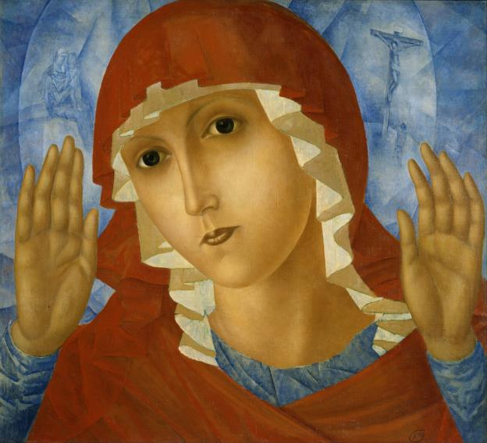
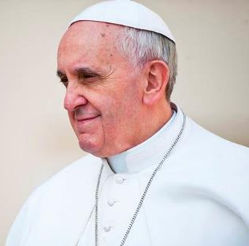
Mary, model of missionaries
‘Mary is a model for Missionaries throughout the world. She not only shows the need for prayer, but also reaches outside herself and serves.’ Pope Francis

Slide 3
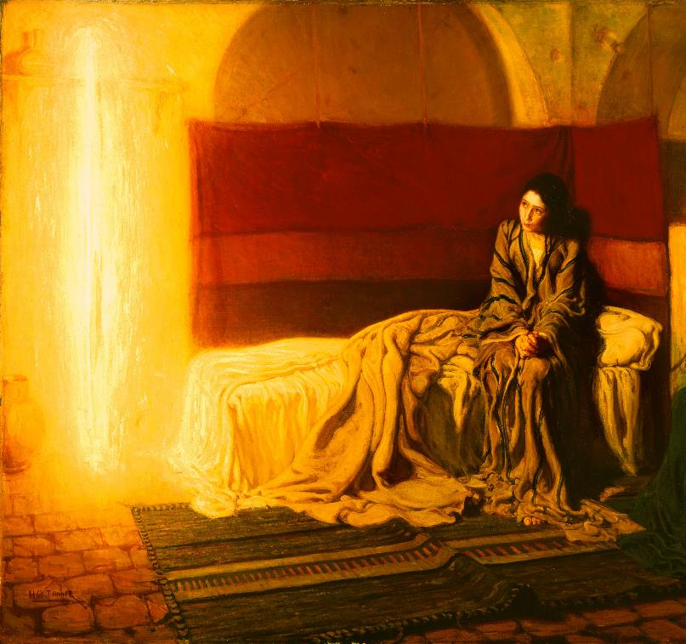
‘Young people are capable of courageous witness and generous deeds.’
Pope Francis

Slide 4
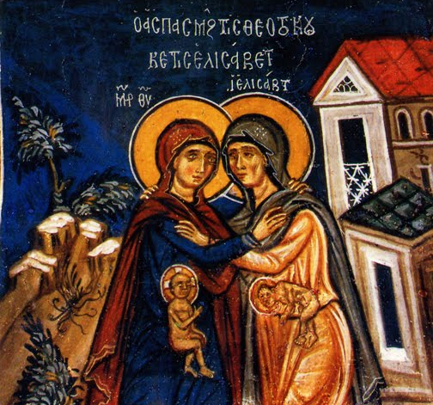
‘When God touches the heart of a young man or woman, they become capable of doing tremendous things.’
Pope Francis

Slide 5
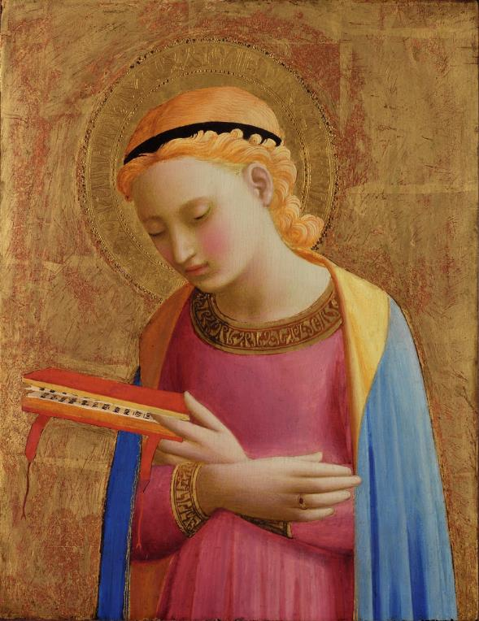
‘Like the young Mary, you can allow your life to become a means for making the world a better place. Jesus is calling you to leave your mark in life, your mark on history.’
Pope Francis

Slide 6
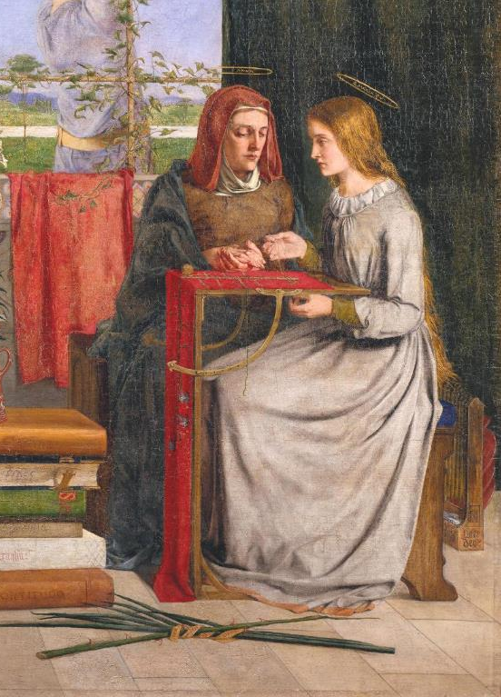
‘In Mary we see that humility is not a virtue of the weak but of the strong who don’t have to treat others badly to feel important.’
Pope Francis

Slide 7
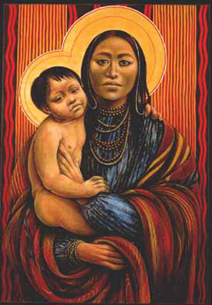
Mary said “My soul glorifies the Lord, my spirit rejoices in God my Saviour.
For he has looked upon his servant
in her littleness.
From now on all generations will call me blessed.
The Almighty has done great things through me. Holy is His name.
God’s mercy extends from age to age, to all who praise him.
Luke 1:46-55

Slide 8
Hail Mary, model of missionaries,
Pray with us for those who suffer,
inspire us to reach out and ease their struggles.
Pray with us for those who rely on our generosity,
help us to share freely.
Pray with us for those who lack humility,
may we learn the value of asking others for help.
Pray for us that we might be
courageous witnesses of your Son’s love.
Joyfully carrying into this world
Christ’s light and hope.
Amen.

Slide 9
Nobody,
no situation
and no place
is beyond God’s care.

