Slide 1
Today. Tomorrow. Together.

Slide 2
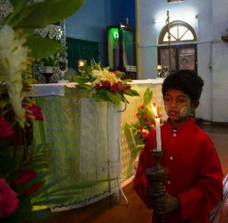
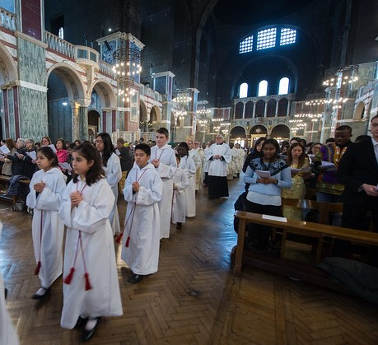
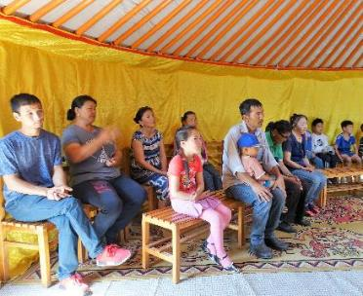
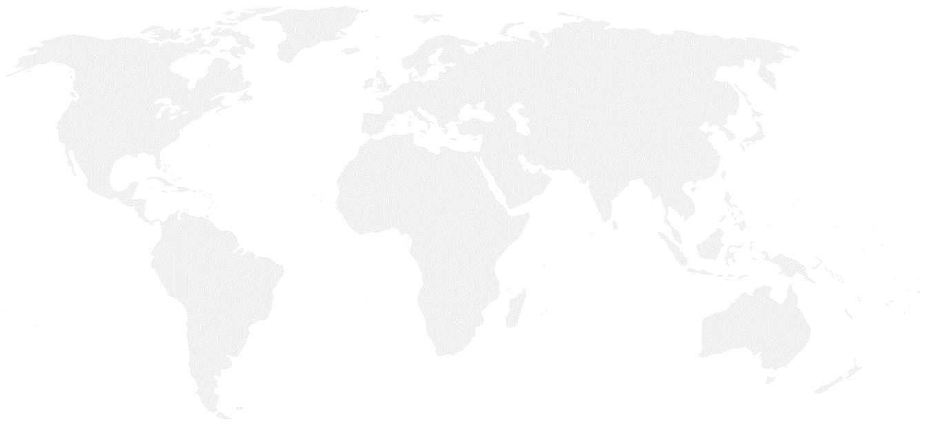
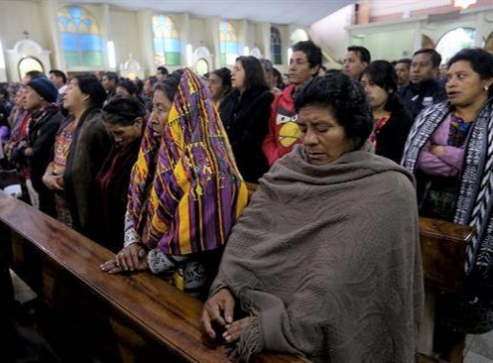
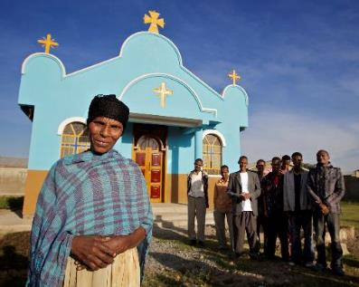
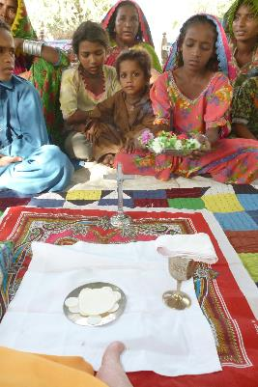
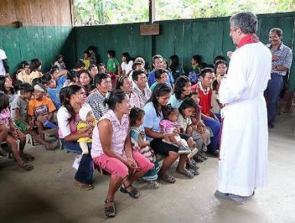
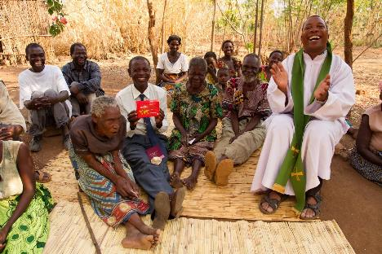
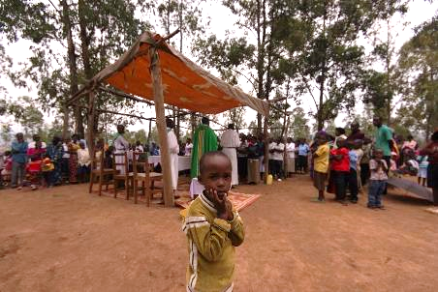
Britain
Mongolia
Myanmar
Guatemala
© Mazur/catholicnews.org.uk
Ethiopia
Peru
Pakistan
Rwanda
Malawi

Slide 3
© Mazur/catholicnews.org.uk
‘Jesus invites us to build together a civilization of love, as his disciples and missionaries, here and now.’ Pope Francis

Slide 4
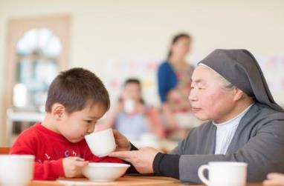
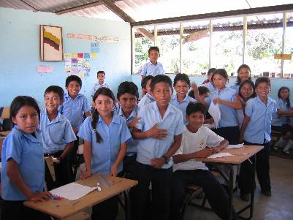
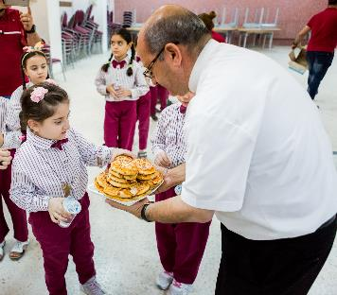
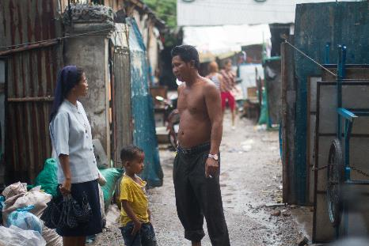
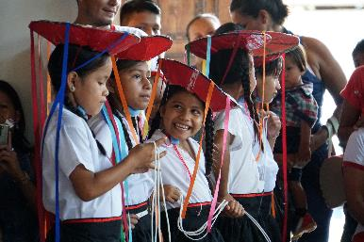
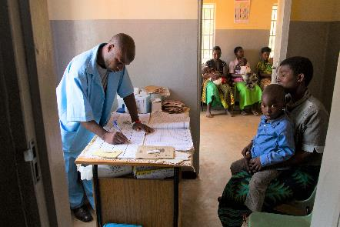
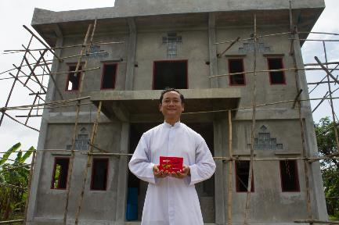
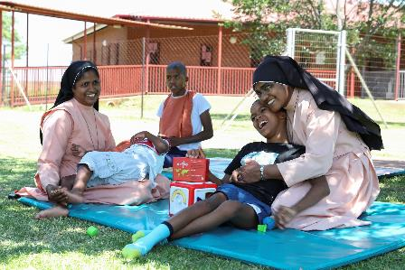
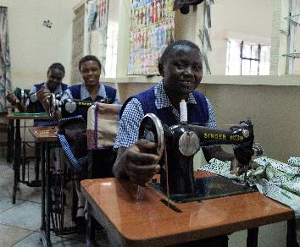
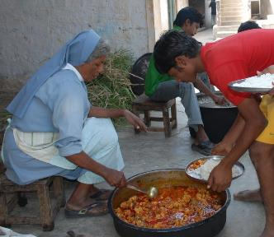
©Missio/TLouapre
Mongolia
Ecuador
Jordan
Cambodia
Myanmar
Peru
Malawi
South Africa
Kenya
India

Slide 5
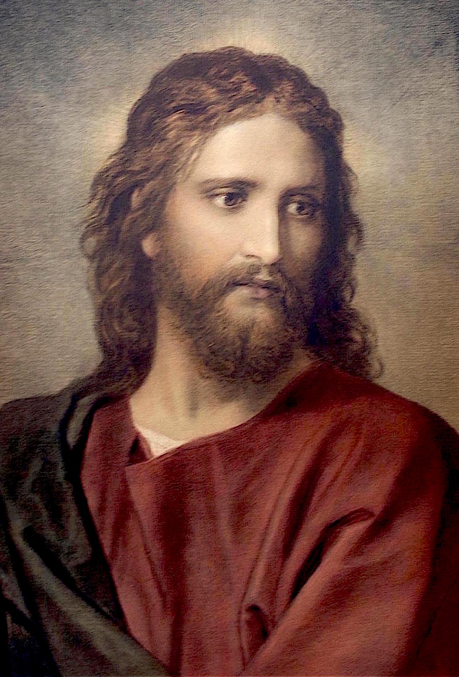
Our Father who art in heaven,
hallowed be thy name.
Thy kingdom come,
Thy will be done
on earth, as it is in heaven.
Give us this day our daily bread,
and forgive us our trespasses,
as we forgive those who trespass against us,
and lead us not into temptation,
but deliver us from evil.
Amen.
‘Jesus said to his followers,
“When you pray, say:
Father, may your name be held holy.
your kingdom come;
give us each day our daily bread,
and forgive us our sins,
For we ourselves forgive each one
who is in debt to us.
And do not put us to the test.”’
Luke 11:2-4
Challenge thinking that divides people. Look for ways to work together, not apart.
Raise money for Missio and support our family around the world who live with poverty and hardship.
Pray for those in need, those close to home and those far away.

Slide 6
Today. Tomorrow. Together.

