Slide 1
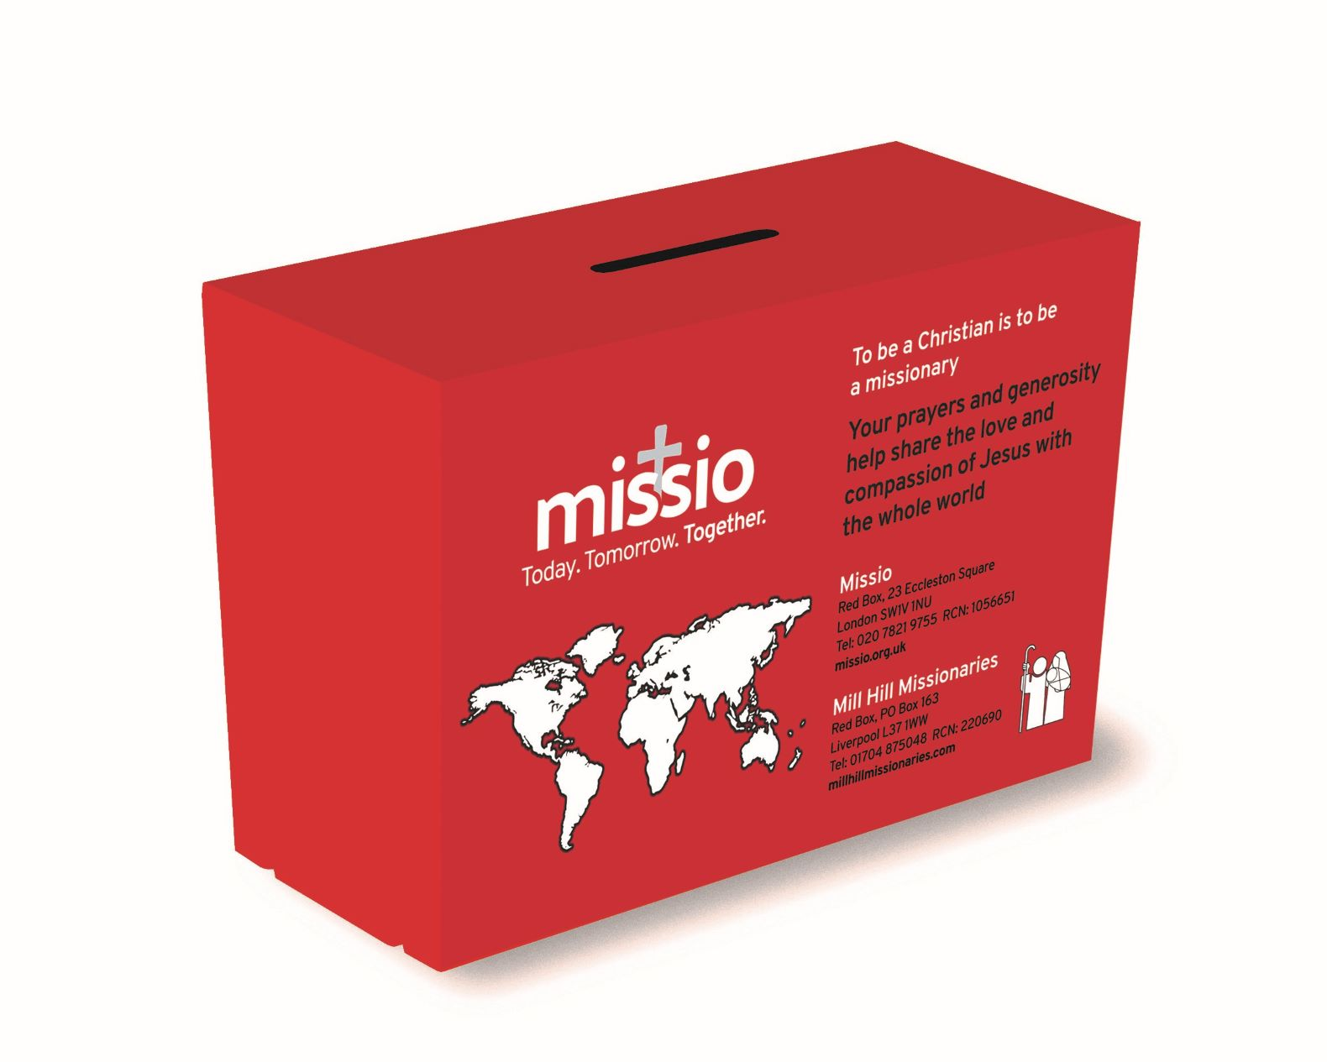
Today. Tomorrow. Together.

Slide 2
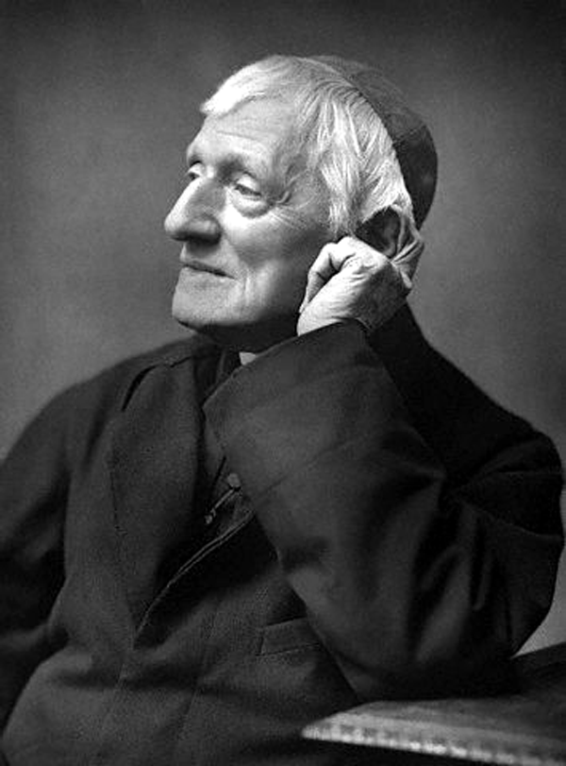
God has created me to do Him some definite service.
He has committed some work to me which he has not committed to another.
I have my mission.
I may never know it in this life,
but I shall be told it in the next.
I am a link in a chain,
a bond of connection between persons.
He has not created me for naught.
I shall do good;
I shall do His work.

Slide 3
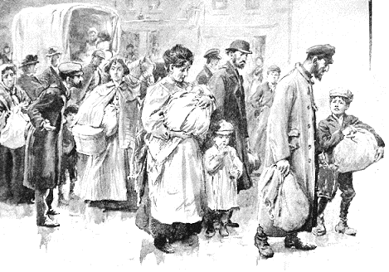
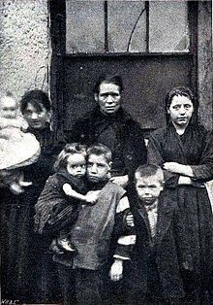
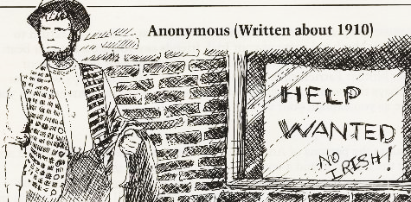
Compassion
Q: Who are the people discriminated against today?
Q: How can we show compassion to them and to others in need of support?

Slide 4
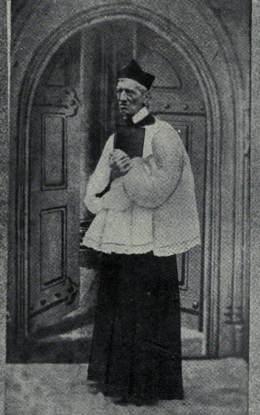
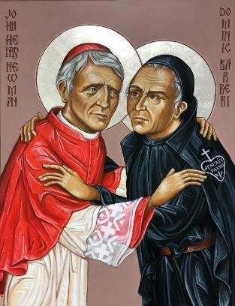
Forgiveness
Q: What do you think helped Saint Newman to forgive?
Q: What could help us to forgive those who’ve hurt us, and what could help us ask for forgiveness from others?

Slide 5
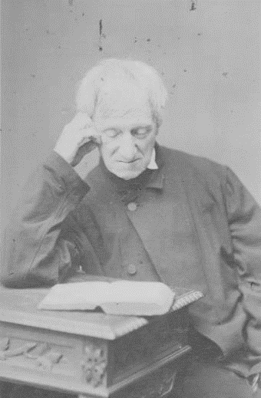
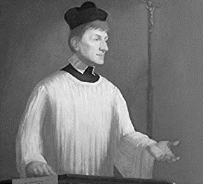
Truthfulness
Q: Can you think of other people who act with integrity and are not afraid to speak the truth?
Q: Who and what could help us to be people who seek the truth and speak the truth?

Slide 6
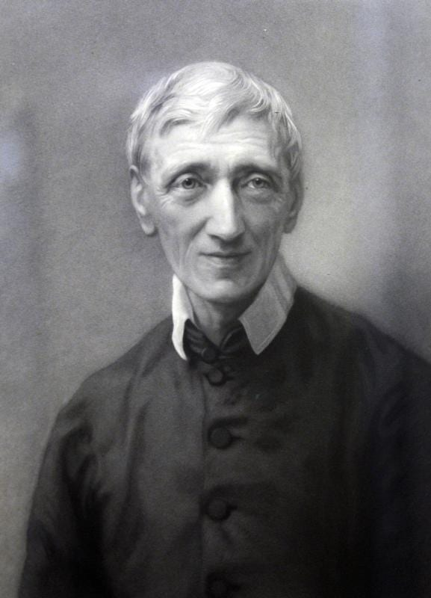
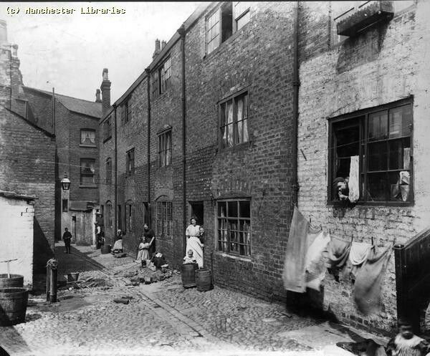
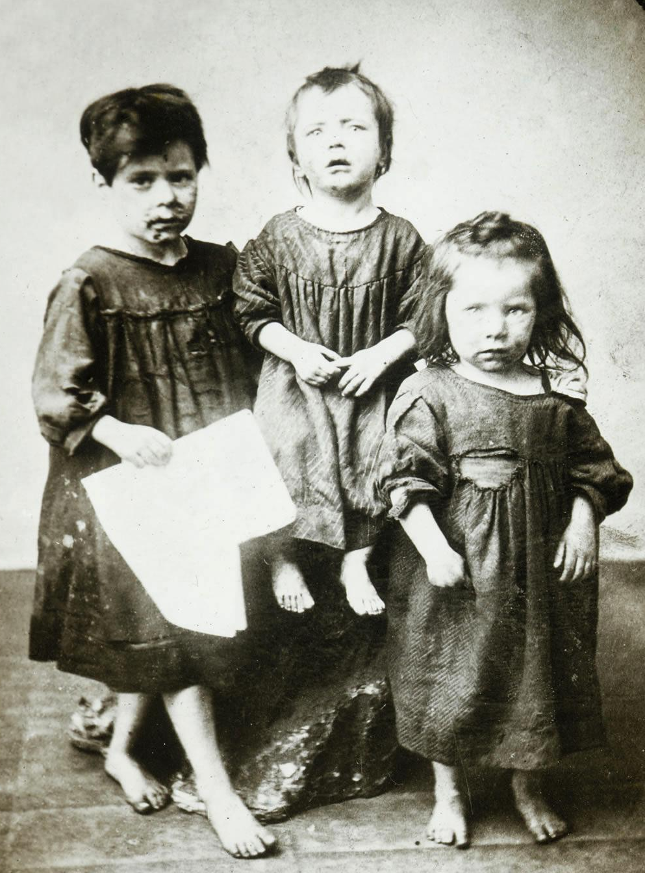
Service
Q: How can you be of service to people who need support?
Q: What might your mission be?

Slide 7
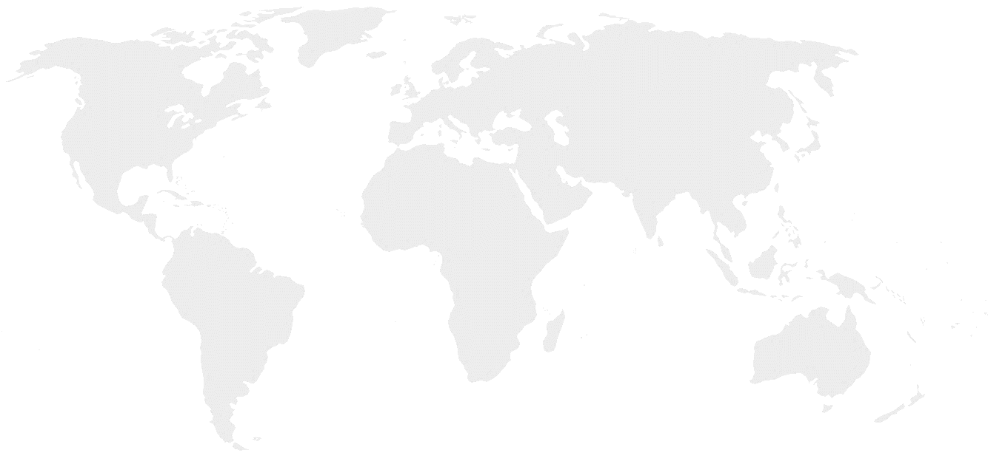
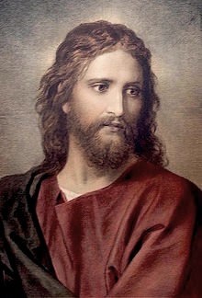
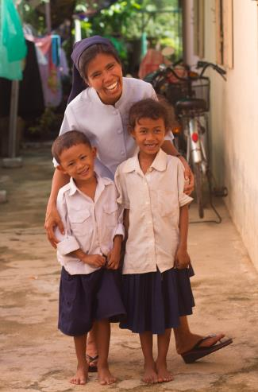
‘God has sent me to give the Good News to the poor.’
Gospel of St Luke 4: 14-18
‘Whatsoever you do to the least of these brothers and sisters of mine, you do it to me.’
Gospel of St Matthew 25:40
https://youtu.be/RvY56FctbZ8 Red Box in Cambodia

Slide 8
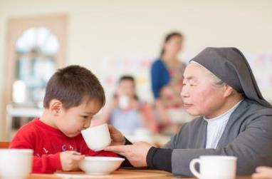
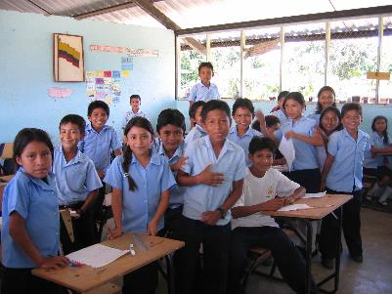
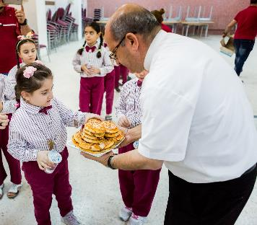
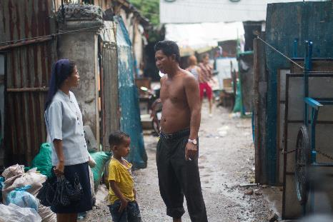
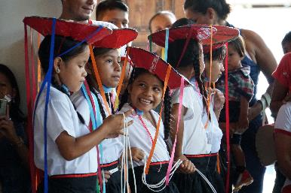
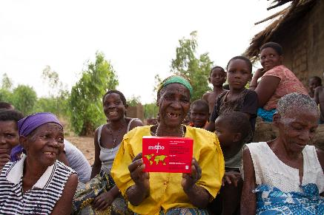
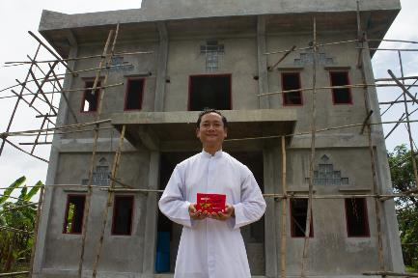
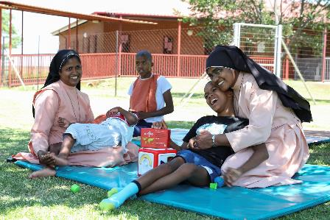
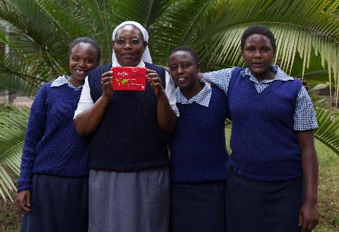
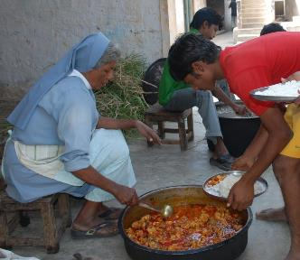
©Missio/TLouapre
Mongolia
Ecuador
Jordan
Cambodia
Peru
Myanmar
Malawi
South Africa
South Africa
Kenya
India

Slide 9
God has created me to do Him some definite service.
He has committed some work to me which he has not committed to another.
I have my mission.
I may never know it in this life, but I shall be told it in the next.
I am a link in a chain, a bond of connection between persons.
He has not created me for nothing.
I shall do good; I shall do His work.
I shall be an angel of peace,
a preacher of truth in my own place,
while not intending it if I do but keep His commandments.
Therefore, I will trust Him, whatever I am,
I can never be thrown away. Amen.

Slide 10
Today. Tomorrow. Together.

