Slide 1
Nobody,
no situation
and no place
is beyond God’s care.

Slide 2
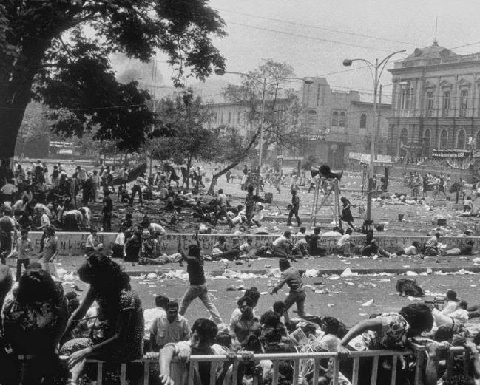
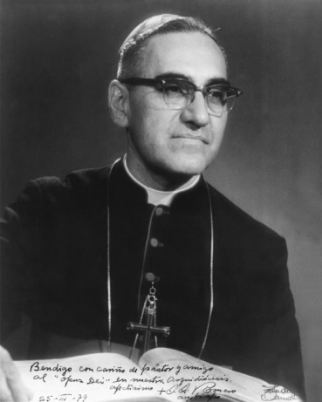
15 August 1917 – 24 March 1980

Slide 4
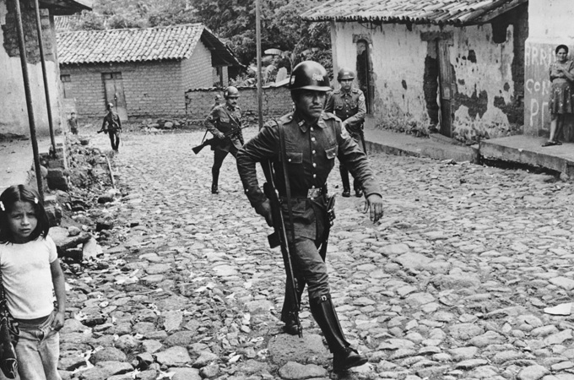
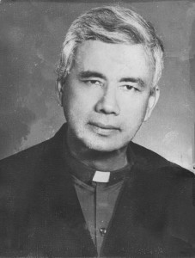
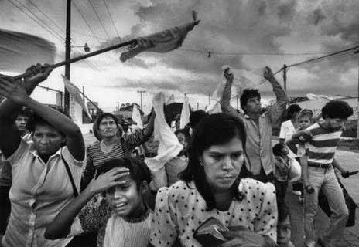

Slide 5
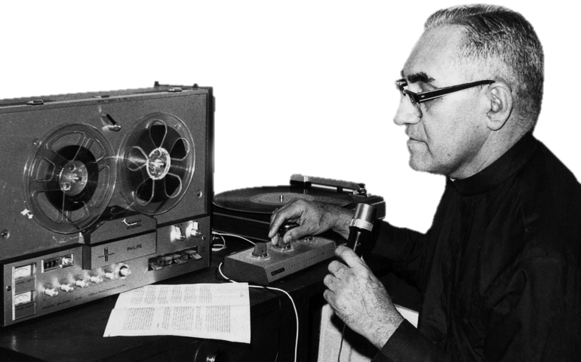
‘Jesus said… “Love one another, just as I have loved you.”’ Gospel of John 13:34

Slide 6
‘It is not God’s will
for some to have everything
and others
to have nothing.’
St Oscar Romero

Slide 7
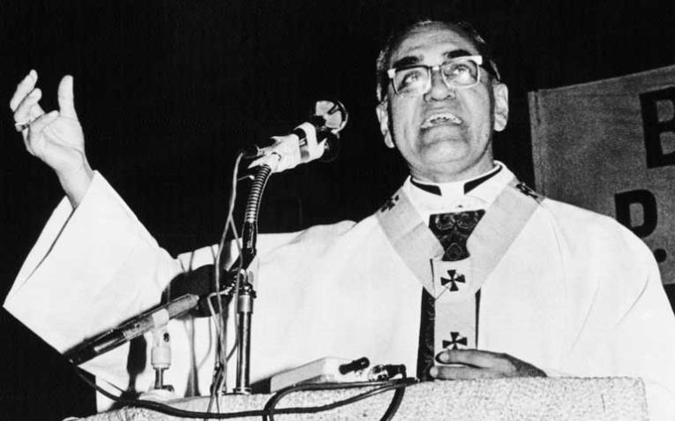
‘In the name of God, and in the name of this suffering people… I beg you, I implore you, I order you, in the name of God, stop the cruelty!’
St Oscar Romero

Slide 8
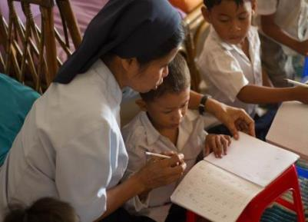
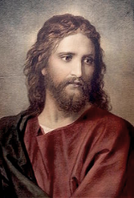
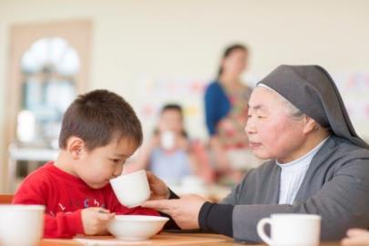
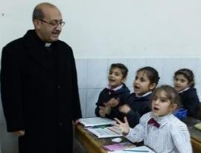
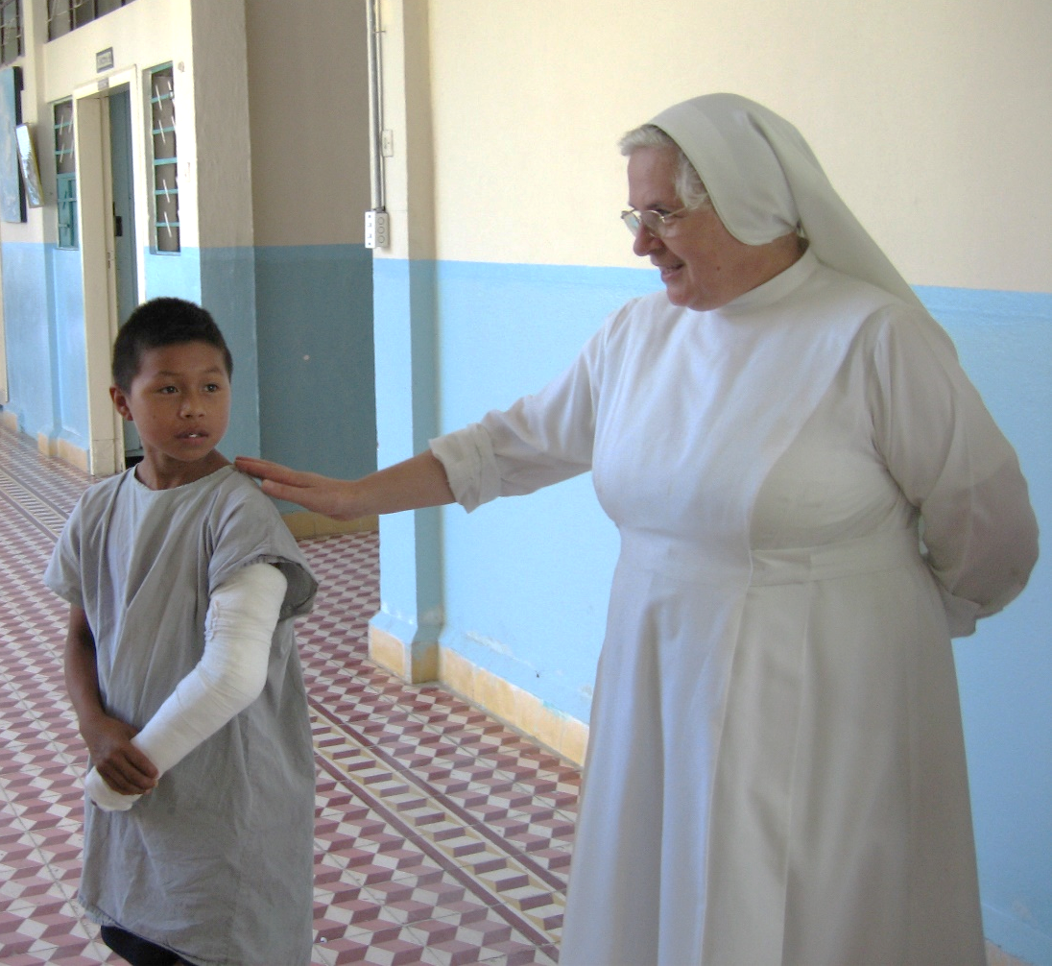
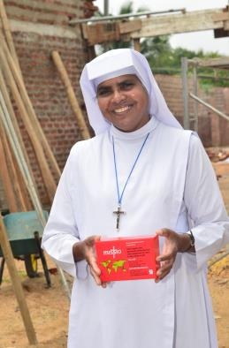
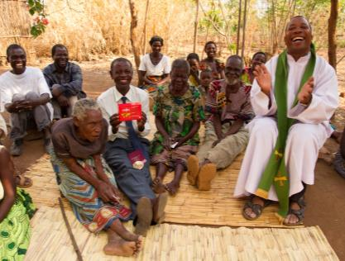
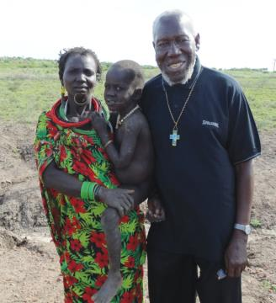

Slide 9
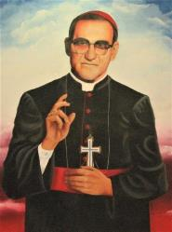
‘The Spirit of the Lord is within me.
God has chosen me to share his message with the poor.
God sends me to tell those in chains that they are free,
and to help those who struggle to see a way forward.
God sends me to support those who are treated unfairly,
And to proclaim a time pleasing to the Lord.
The Lord sends me to be a missionary of his love.’
Amen.
Adapted from Luke 4:18

Slide 10
Nobody,
no situation
and no place
is beyond God’s care.

