Slide 1
Catholic Social Teaching:
Dignity of Work

Slide 2
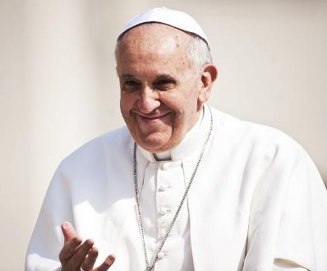
‘The Lord wants to turn your hands, my hands, our hands, into signs of reconciliation, of communion, of creation.’
Pope Francis

Slide 3
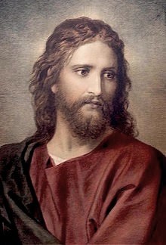
The vineyard owner answered. ‘Friend,
I am doing you no wrong; did you not agree with me for the usual daily wage?
Take what belongs to you and go; I choose to give to the person hired later in the day, the same as I give to you, hired first thing. Am I not allowed to do what I choose with what belongs to me? Or are you envious because I am generous?’
Gospel of Matthew 20: 1-16 (abridged)

Slide 4
Human Dignity
Care of Creation
Catholic Social Teaching
Community and Participation
Dignity of Work
Solidarity

Slide 5
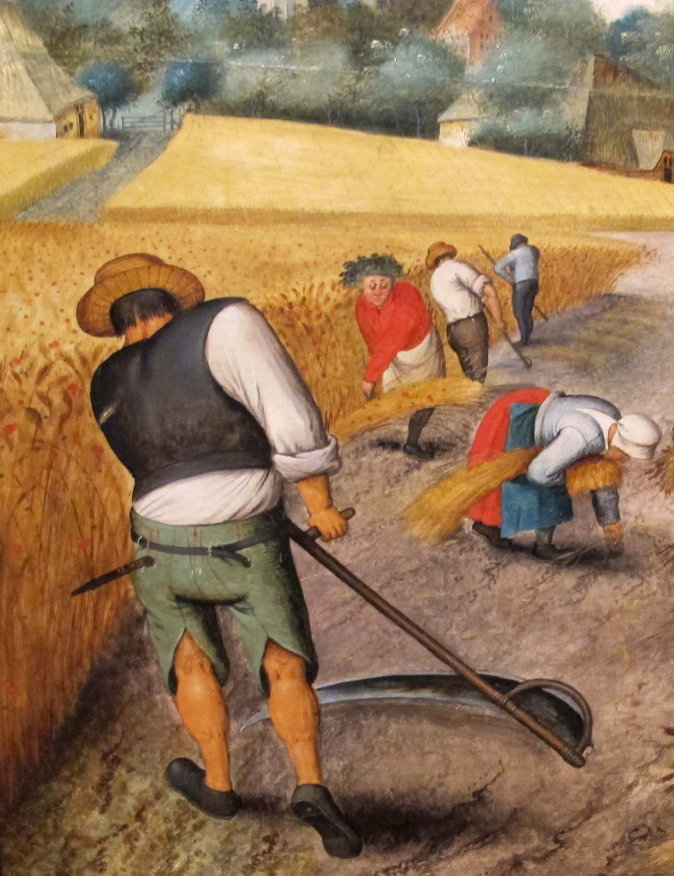
Dignity of Work
‘We do not get dignity from power or money or culture. We get dignity from work. [Work] makes us similar to God who has worked and still works, who always acts.’ Pope Francis

Slide 6
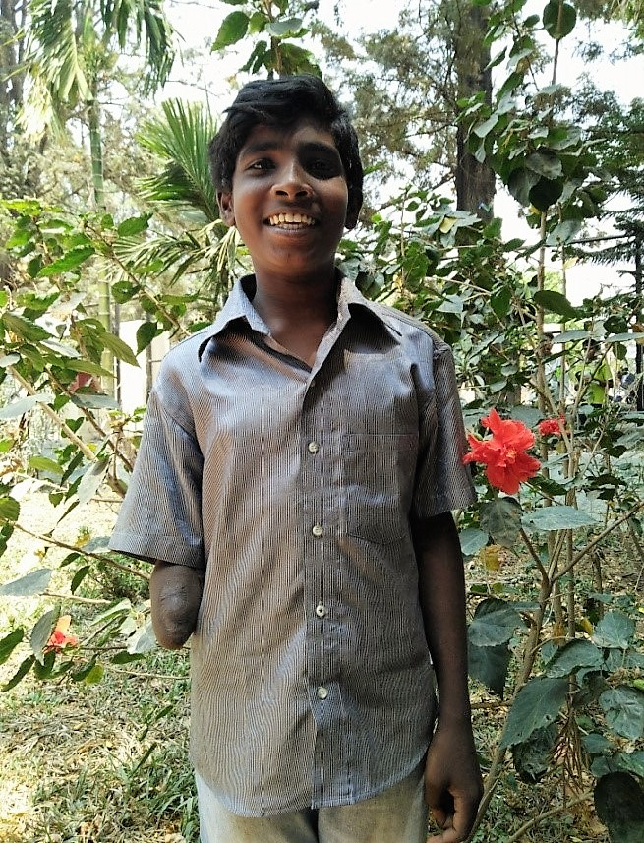
Dignity of Work
Samuel’s story

Slide 7
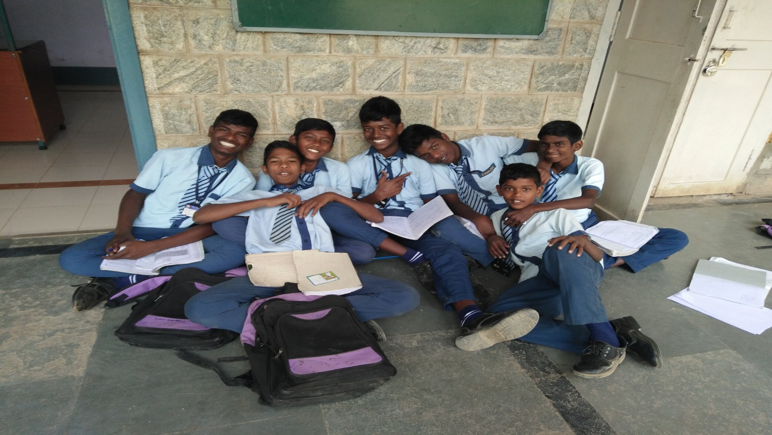
Call to Action: Serve the server
Serve the server
Call to Action: Chores for charity
Call to Action:
Commit to reading the Gospel

Slide 8
Lord, you look with love upon us in our work,
Whether a pupil, a cleaner, a builder, a teacher.
All our efforts to better our lives and our world
are pleasing to you.
You had your own particular work to do,
To share your love with the world.
Help us to make this our life’s work too.
To be missionaries of God’s love.
Amen

Slide 9
Nobody,
no situation
and no place
is beyond God’s care.

