Slide 1
Nobody,
no situation
and no place
is beyond God’s care

Slide 2
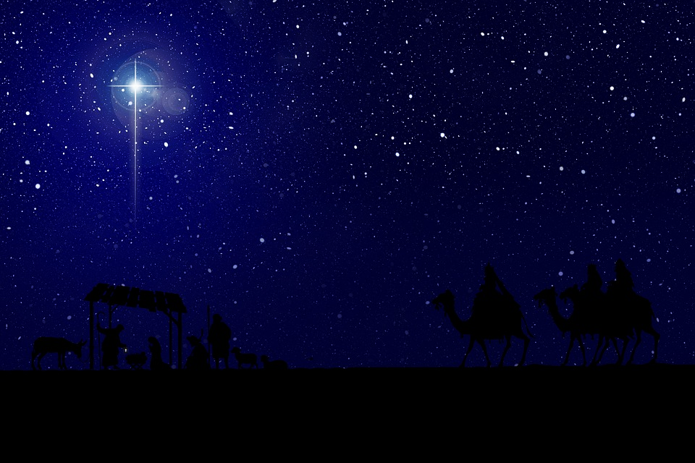
‘Truly He taught us
to love one another
His law is love
and His gospel is peace
Chains He shall break
For the slave is our brother
And in His Name
All oppression shall cease.’

Slide 3
‘The angel said, “Do not be afraid. Listen, I bring you news of great joy, a joy to be shared the whole people. Today in the town of David a saviour has been born to you; he is Christ the Lord.”’
Luke 2:10-11

Slide 4
Nobody,
no situation
and no place
is beyond God’s care

